Slide 1

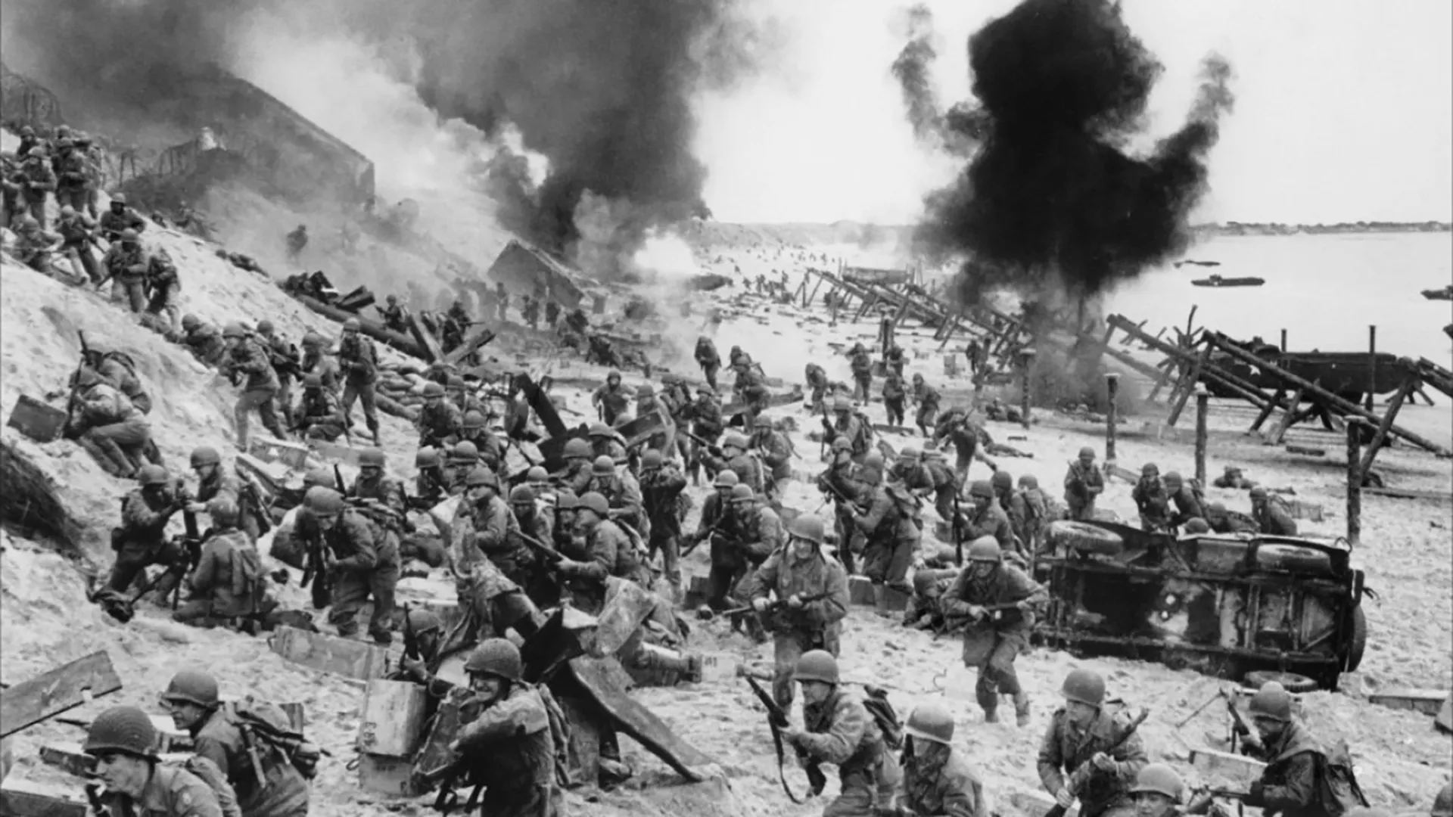





1939-1945
Chapter 25
WORLD WAR II
world war ii
Strand Two: The History of Ireland
@MsDoorley

Slide 2
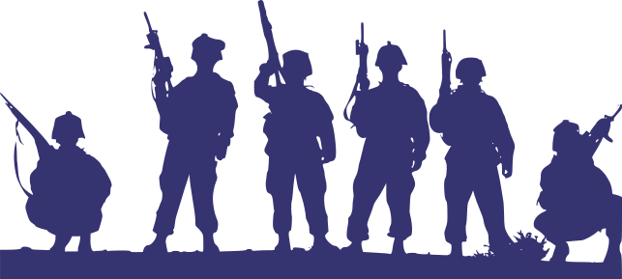
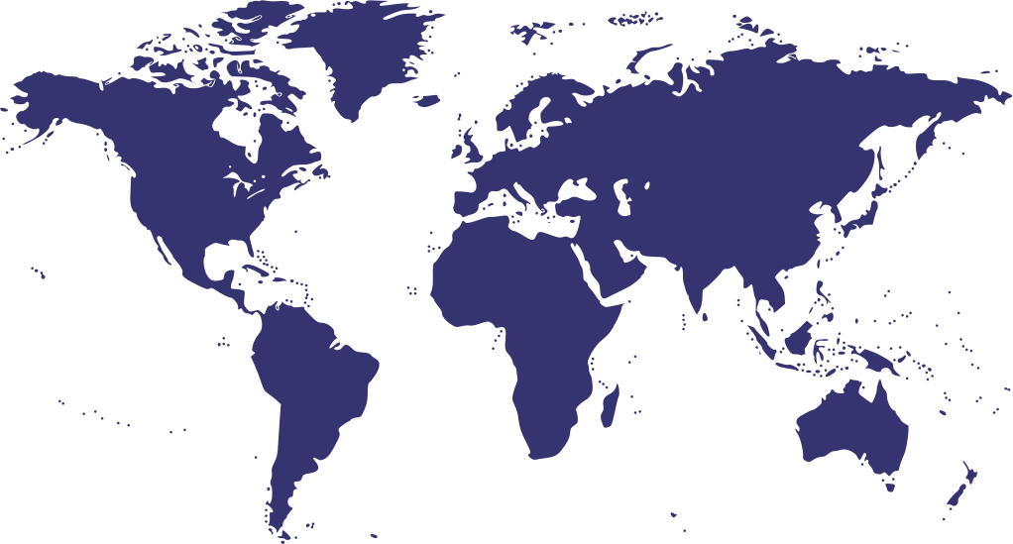



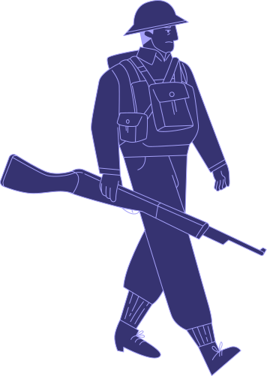
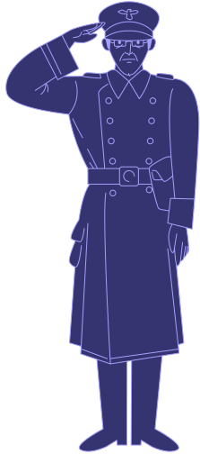
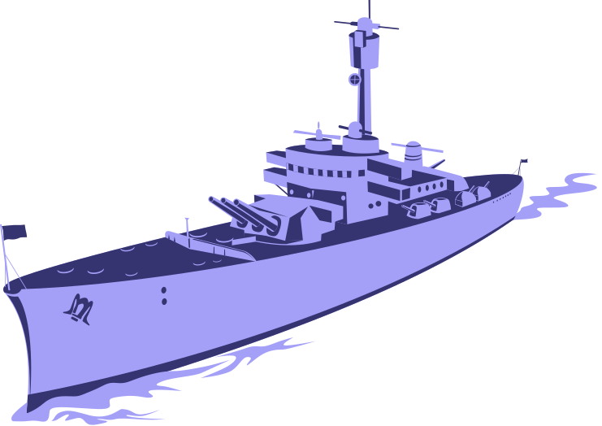
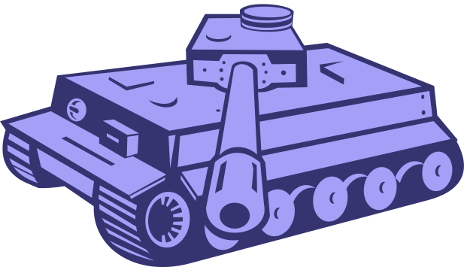






Chapter 25.1
WORLD WAR II
Hitler invades France: The evacuation of Dunkirk takes place followed by the Battle of Britain.
The Battle of Stalingrad marks the turning point of the war in favour of the Allies.
Nazi Germany surrenders to the Allies on 7th May, following Hitler's suicide.
1939
1940
1941
1942
1944
May 1945
Chapter Twenty-Five: World War II
Strand Two & Three: The History of the World
Aug 1945
World War II begins with Germany's invasion of Poland.
Hitler breaks the Nazi-Soviet Nonaggression Pact with Operation Barbarossa. Japan attacks Pearl Harbour.
The Allies launch their counter-offence, Operation Overlord with the D-Day Landings in Normandy, France.
The US drop atomic bombs on the cities of Hiroshima and Nagasaki, bringing the war to its end.
@MsDoorley

Slide 3
Learning Outcomes
3.4 DISCUSS the general causes and course of World War I or World War II and the immediate and long-term impact of the war on people and nations.
3.11 EXPLORE the contribution of technological developments and innovation to historical change.
1.2 CONSIDER contentious or controversial issues in history from more than one perspective and discuss the historical roots of a contentious or controversial issue or theme in the contemporary world
1.7 DEVELOP historical judgements based on evidence about personalities, issues and events in the past, showing awareness of historical significance
1.9 DEMONSTRATE awareness of the significance of the history of Ireland and of Europe and the wider world across various dimensions, including political, social, economic, religious, cultural and scientific dimensions
1.11 MAKE CONNECTIONS AND COMPARISONS between people, issues and events in different places and historical eras
Strand Two & Three: The History of the World
Chapter Twenty-Five: World War II
@MsDoorley

Slide 4
Introduction
World War II was declared in September 1939. The two opposing sides were the Allied Powers (Britain, France and Poland; later joined by the USSR and the USA) and the Axis Powers (Germany, Italy and Japan).
While World War I had been fought almost entirely along two fronts, this war would spill across all of Europe and beyond, from Belfast to the USSR, from Scandinavia to North Africa, and (from 1941) also throughout the Pacific region. Major developments in technology changed the nature of combat on land, at sea and in the air - and affected civilians like never before. World War II resulted in the deaths of over 60 million people, while approximately 40 more were refugees when the war ended.
Strand Two & Three: The History of the World
Chapter Twenty-Five: World War II
@MsDoorley

Slide 5
1939-1945
Chapter 25
25.1: THE CAUSES OF WORLD WAR II
25.1: the causes of world war ii
Strand Two: The History of Ireland
@MsDoorley

Slide 6
1939-1945
Chapter 25
25.1.1: HITLER'S FOREIGN POLICIES
25.1.1: hitler's foreign policies
Strand Two: The History of Ireland
@MsDoorley

Slide 7
Hitler's Main Aims
The Treaty of Versailles had weakened Germany terribly. Its restrictions were unacceptable to Hitler, and he planned to defy them and reclaim Germany's power and territory by:
  Rebuilding the German army and navy
  Re-occupy the Rhineland
  Regaining the territory lost after World War I
  Expanding further into a 'greater Germany' by uniting all German speakers under a policy called Lebensraum. This German Empire would be known as the Third Reich, or 'third regime or empire'.
Hitler knew that Britain and France would be anxious to avoid another war. Nor was Germany strong enough - yet. He was careful to only push a little at a time.
Strand Two & Three: The History of the World
Chapter Twenty-Five: World War II
@MsDoorley

Slide 8
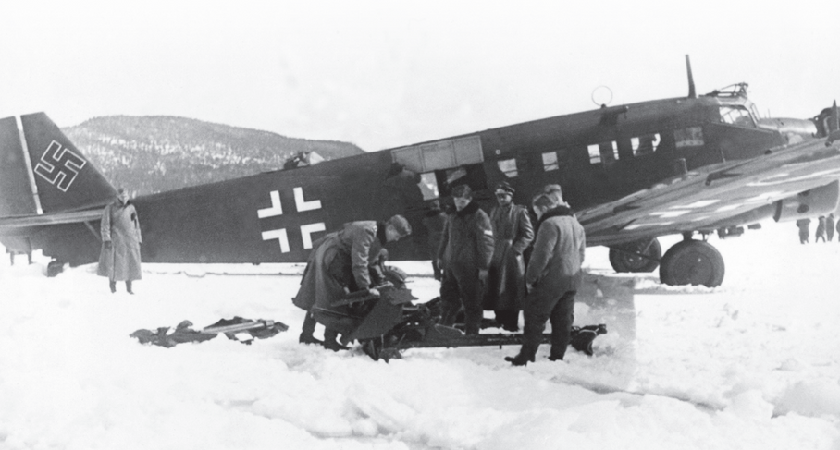
Rebuilding the army and navy
The Treaty had restricted the German Army to 100,000 men and banned it from having an airforce, tanks or submarines. In 1933, Hitler withdrew Germany from the League of Nations.
In 1935, the Anglo-German Naval Agreement was signed, regulating the size of the Germany navy in relation to the British navy. The British had made this agreement without consulting France or Italy and it actually granted Germany the right to expand its navy beyond the limits set by the Treaty of Versailles. This gave Hitler confidence.
In the same year, Germany reintroduced conscription and soon the army numbers had grown to 100,000, far beyond its Treaty limits. Hitler then increased the size of the navy and created an airforce, called the Luftwaffe. No steps were taken by Britain or France to halt Germany's dramatic military growth.
Strand Two & Three: The History of the World
Chapter Twenty-Five: World War II
Diagram taken from Artefact, 2nd Edition by Eimear Jenkinson and Gregg O'Neill (educate.ie)
@MsDoorley

Slide 9
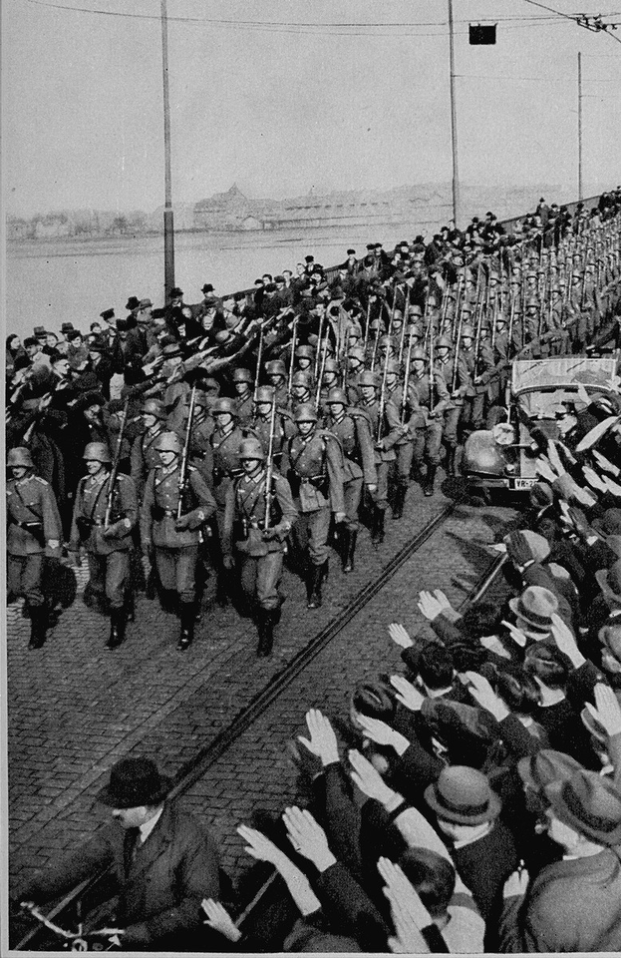
Re-occupation of the Rhineland, 1936
German troops had been forbidden to occupy the region bordering France, called the Rhineland. In March 1936, Hitler sent troops into the Rhineland with orders to retreat if France sent its army to meet them. The German troops were greeted by cheering crowds as they crossed the River Rhine. Once again, Britain and France did not react.
1936 also saw the signing of the Rome-Berlin Axis, linking Italy and Germany together while also stating that they would support each other in war.
Strand Two & Three: The History of the World
Chapter Twenty-Five: World War II
Diagram taken from Artefact, 2nd Edition by Eimear Jenkinson and Gregg O'Neill (educate.ie)
@MsDoorley

Slide 10
The Anschluss, 1938
First on the list for Lebensraum was Austria: a German-speaking country, Hitler's birthplace and somewhere the Nazi Party had strong support. The Treaty of Versailles had specifically forbidden Germany and Austria to unite.
In February 1938, Hitler threatened the Austrian Chancellor with war unless he let Austrian Nazis into his government. The Chancellor tried to limit the Nazis' grasp on power but was replaced by a Nazi chancellor, who immediately invited German troops to enter Austria. An agreement was then signed, absorbing Austria into the Third Reich. Hitler entered the Austrian capital Vienna, greeted by cheering crowds.
France and Britain, again, did not react.
Strand Two & Three: The History of the World
Chapter Twenty-Five: World War II
@MsDoorley

Slide 11
Checkpoint pg. 315 (Artefact, 2nd Edition)
  What were Hitler’s foreign policy aims?
  How did Hitler try to dismantle the Treaty of Versailles?
  What occurred in the Rhineland in 1936? Why is this an important milestone on the road to war?
  What was the Anschluss? How was it achieved?
  How did Britain and France react to Hitler’s foreign policy? Explain your answer using at least two examples.
Strand Two & Three: The History of the World
Chapter Twenty-Five: World War II
@MsDoorley

Slide 12
Checkpoint pg. 315 (Artefact, 2nd Edition)
1. Hitler’s foreign policy aims were: to rebuild the German army and navy; to re-occupy the Rhineland; to regain territory lost after World War I; and to unite all German speakers in an expanded Germany under a policy called Lebensraum.
2. Hitler tried to dismantle the Treaty of Versailles by reintroducing conscription and growing the army beyond its Treaty limits. He then increased the size of the navy (past the Treaty limits, thanks to the Anglo-German Naval Agreement) and created an airforce called the Luftwaffe.
3. In 1936 Hitler sent troops into the Rhineland with orders to retreat if France sent its army to meet them. It’s an important milestone on the road to war because Germany had been forbidden to do exactly this, but got away with it because neither France nor Britain responded. It gave Hitler more confidence.
4. The Anschluss was the joining together of Germany and Austria. It was achieved by the Austrian chancellor being replaced by a Nazi chancellor who invited German troops to enter Austria. The Nazi Party had strong support in Austria. An agreement was signed absorbing Austria into the Third Reich 5. Britain and France did not react to Hitler’s foreign policies. For example, they did not act when he entered the Rhineland, or interfere when the Anschluss happened, or when Germany annexed the remainder of Czechoslovakia, overstepping previous agreements.
Strand Two & Three: The History of the World
Chapter Twenty-Five: World War II
@MsDoorley

Slide 13
1939-1945
Chapter 25
25.1.2: THE PATH TO WAR
25.1.2: the path to war
Strand Two: The History of Ireland
@MsDoorley

Slide 14
The attitude of France and Britain
So far, both France and Britain had stood by and made no response while Hitler rebuilt the Germany army and navy, entered the Rhineland and joined with Austria. There were a number of reasons for this:
  France did not want to risk a war with Germany over the Rhineland, especially as the size of the German Army was unknown.
  France believed its system of fortification along its eastern border with Germany, called the Maginot Line, would be enough to prevent a German attack.
  Most British people believed the terms of the Treaty had been too harsh.
  The memory of World War I was still strong in Britain and the idea of another war so soon was terrible. Britain had also come under fire for its military violence in Ireland during the Irish War of Independence.
  France, Britain and most other Europeans were more concerned about Stalin and the threat of communism than they were of fascism.
Strand Two & Three: The History of the World
Chapter Twenty-Five: World War II
@MsDoorley

Slide 15
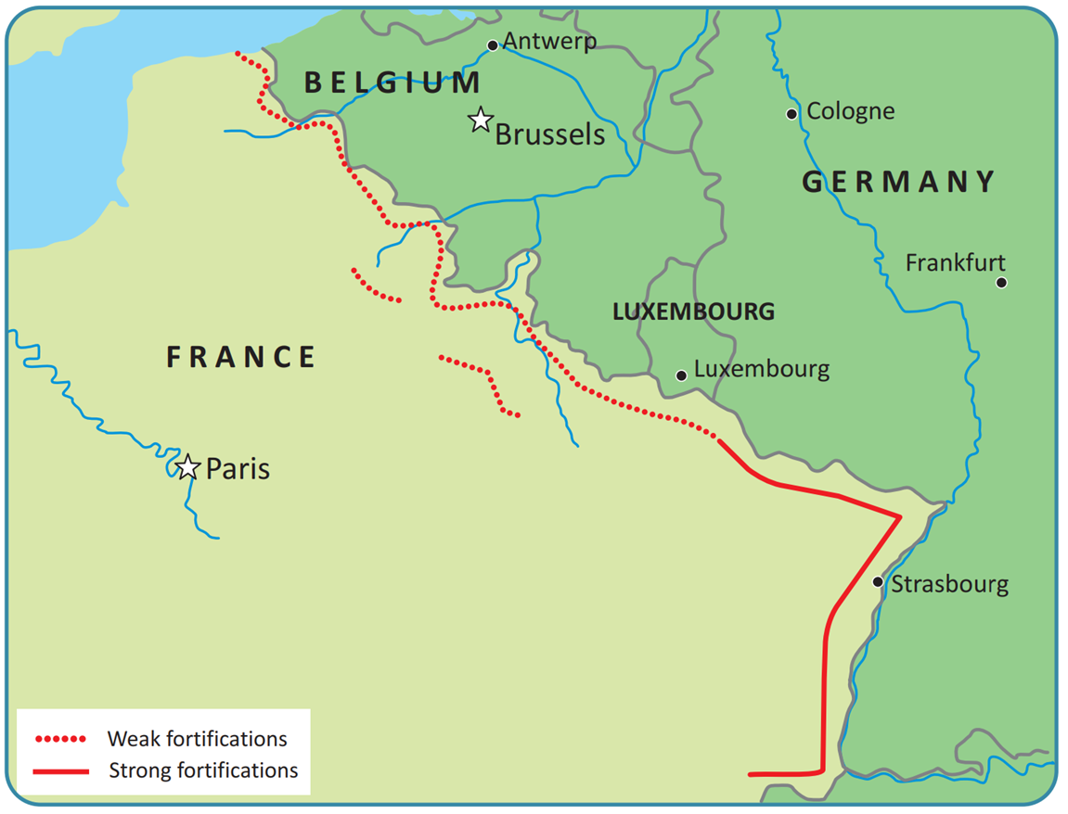
Strand Two & Three: The History of the World
Chapter Twenty-Five: World War II
Diagram taken from Artefact, 2nd Edition by Eimear Jenkinson and Gregg O'Neill (educate.ie)
@MsDoorley

Slide 16
Appeasement
Awareness of all the lives lost in the horrors of World War I was very fresh in British minds. In the 'Peace Ballot' of 1934-35, millions of British people voted for a pacifist (pro-peace) approach, and since then appeasement had been British foreign policy. Appeasement involved agreeing to Hitler's demands in the hope of avoiding war. The British Prime Minister in 1937 was Neville Chamberlain, who said 'We should seek by all means in our power to avoid war, by analysing possible causes, by trying to remove them, by discussion in a spirit of collaboration and good will'. Hitler saw Britain's reluctance to engage assertively and took advantage of this.
Strand Two & Three: The History of the World
Chapter Twenty-Five: World War II
@MsDoorley

Slide 17
Checkpoint pg. 316 (Artefact, 2nd Edition)
  Why did France want to avoid war with Germany?
  Why was Britain opposed to using force in response to German actions?
  What was the policy of appeasement?
Strand Two & Three: The History of the World
Chapter Twenty-Five: World War II
@MsDoorley

Slide 18
The Sudetenland and The Munich Conference, 1938
Hitler noted Europe's lack of authority and realised that he could go further. His next aim was to absorb the German-speakers in Czechoslovakia into the Reich. The majority German-speaking regions of Czechoslovakia were together called the Sudetenland. The Germans living there were encouraged to campaign for independence. Nazi propaganda made it look as though the Czechoslovakian state had been mistreating the Sudeten Germans.
In September 1938, Neville Chamberlain, Adolf Hitler, Benito Mussolini and Édouard Daladier (French President) met for the Munich Conference to discuss the issue of Czechoslovakia and the Sudetenland. They agreed to make the German-speaking part Czechoslovakia a part of Germany. Notably, Czechoslovakia was not part of the talks. Hitler promised the other leaders that he would not demand any more territory. Chamberlain returned to Britain to cheering crowds, claiming to have achieved 'peace for our time'.
In March 1939, Hitler broke the Munich Agreement and took over the rest of Czechoslovakia. Now nobody could deny that appeasement had been a failure. Britain began to rearm itself, reintroduced conscription and began to make agreements with other countries, such as France and Poland, against Hitler. Britain and France promised Poland that they would come to its aid if Germany invaded. They hoped that Stalin would agree to do the same, but talks with him broke down.
Strand Two & Three: The History of the World
Chapter Twenty-Five: World War II
@MsDoorley

Slide 19
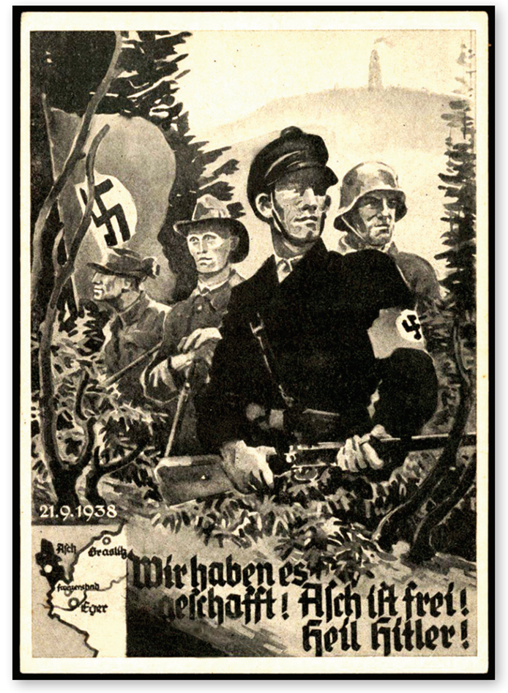
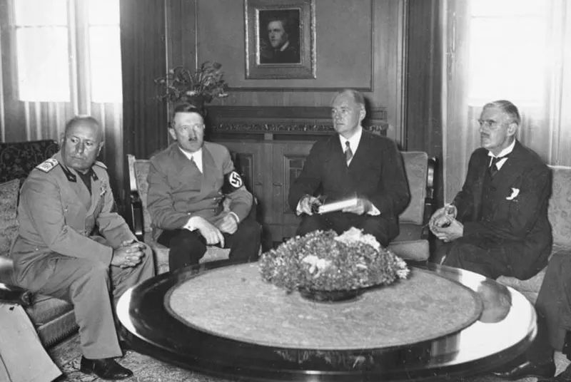
Strand Two & Three: The History of the World
Chapter Twenty-Five: World War II
Diagram taken from Artefact, 2nd Edition by Eimear Jenkinson and Gregg O'Neill (educate.ie)
@MsDoorley

Slide 20
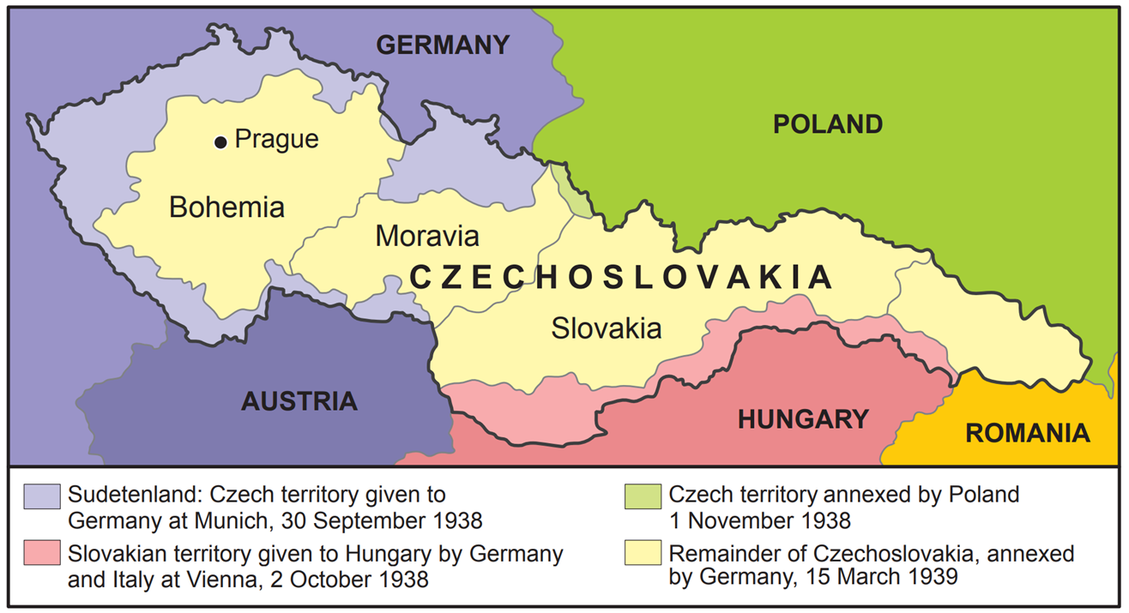
Strand Two & Three: The History of the World
Chapter Twenty-Five: World War II
Diagram taken from Artefact, 2nd Edition by Eimear Jenkinson and Gregg O'Neill (educate.ie)
@MsDoorley

Slide 21
The Nazi-Soviet Non-Aggression Pact
Fascism and communism are natural enemies, and Hitler had sworn to eliminate communism. It was therefore a shock for European leaders when Stalin and Hitler signed the Nazi-Soviet Non-Aggression Pact (also called the Molotov-Ribbentrop Pact) in August 1939. Under this, they agreed upon:
  a ten-year period when they would not attack each other or help each other’s enemies.
  a secret clause: an agreement to partition Poland between them, and also that the Baltic States (Finland, Estonia, Latvia and Lithuania) and Romania would belong to a Russian 'sphere of influence'.
This pact led Stalin to believe that he was safe from German attack. The Red Army was not ready for war; it had recently lost thousands of senior officers to Stalin's purges.
Hitler was planning to invade Poland and this pact meant that he need not worry about the USSR reacting aggressively from the east. By taking western Poland, he would gain the strategically important port city of Danzig (modern Gdansk) and reclaim the 'Polish Corridor' and a lot of former German territory.
On 1st September 1939, Germany invaded Poland. Two days later, Britain and France declared war on Germany. World War II had begun.
Strand Two & Three: The History of the World
Chapter Twenty-Five: World War II
@MsDoorley

Slide 22
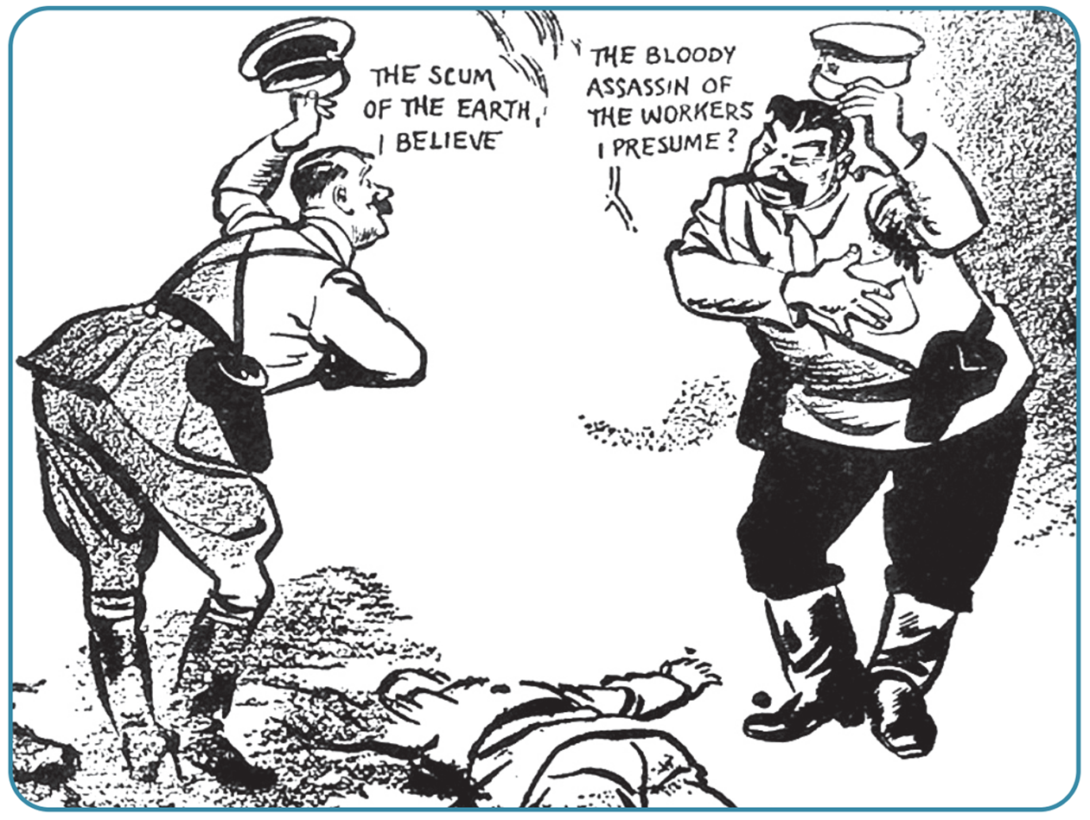
Strand Two & Three: The History of the World
Chapter Twenty-Five: World War II
Diagram taken from Artefact, 2nd Edition by Eimear Jenkinson and Gregg O'Neill (educate.ie)
@MsDoorley

Slide 23
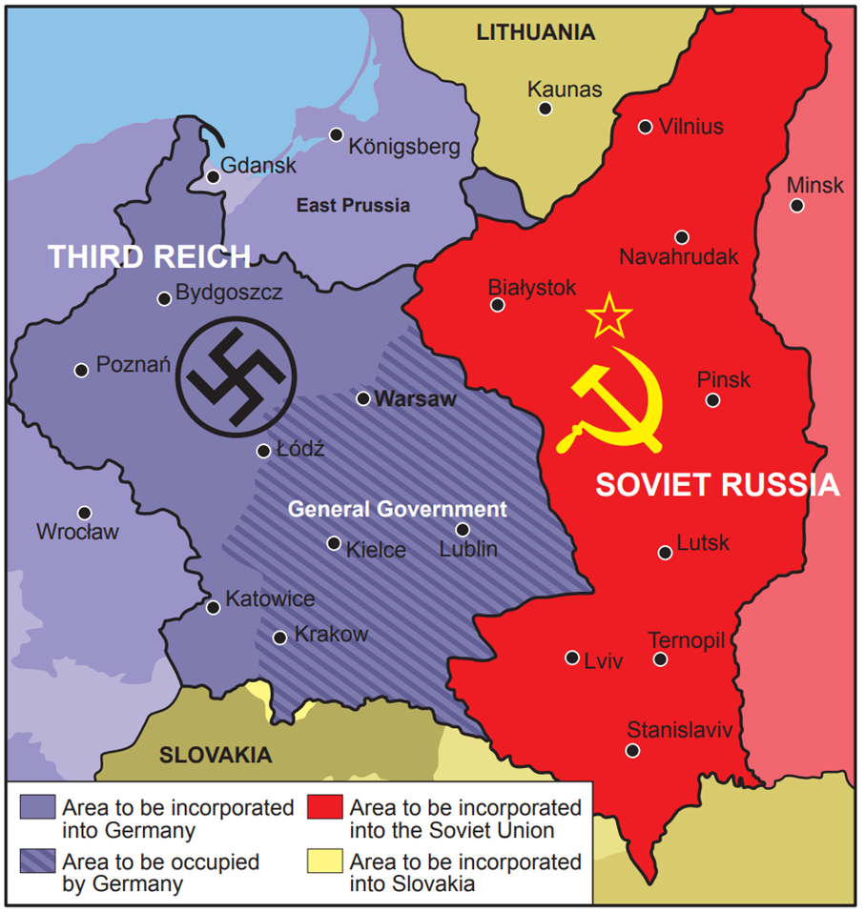
Strand Two & Three: The History of the World
Chapter Twenty-Five: World War II
Diagram taken from Artefact, 2nd Edition by Eimear Jenkinson and Gregg O'Neill (educate.ie)
@MsDoorley

Slide 24
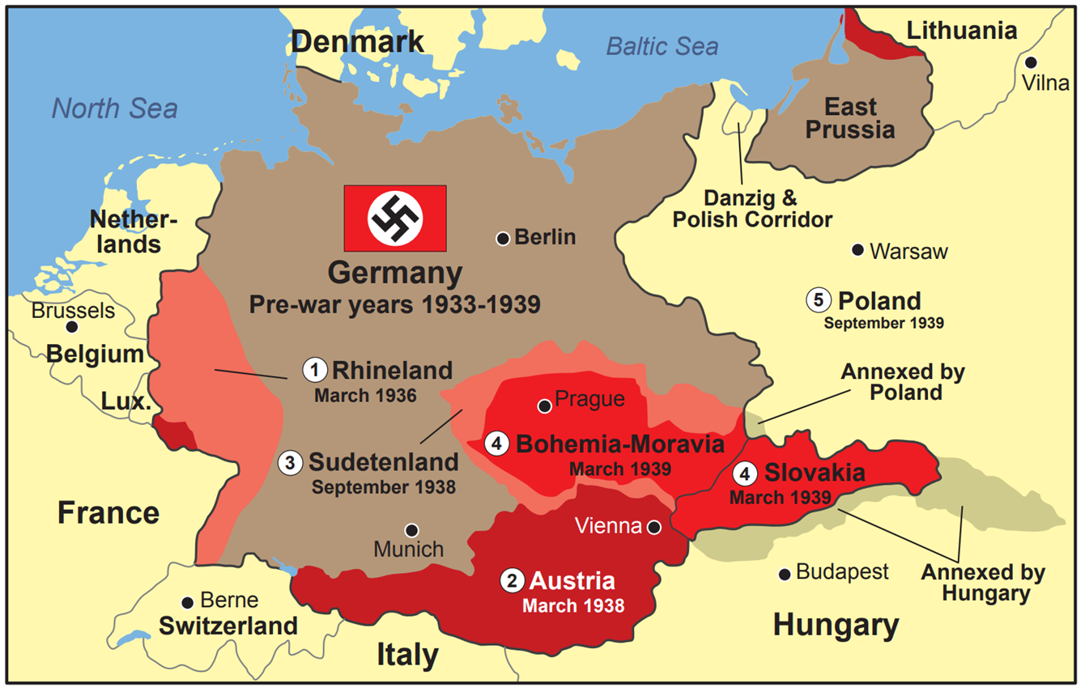
Strand Two & Three: The History of the World
Chapter Twenty-Five: World War II
Diagram taken from Artefact, 2nd Edition by Eimear Jenkinson and Gregg O'Neill (educate.ie)
@MsDoorley

Slide 25
Checkpoint pg. 319 (Artefact, 2nd Edition)
  What was the Sudetenland?
  Who attended the Munich Conference? Why did it take place?
  What was agreed there?
  What was the result of the Nazi takeover of Czechoslovakia?
  What did Hitler and Stalin agreed in the Nazi-Soviet Non-aggression Pact?
  How did World War II begin?
Strand Two & Three: The History of the World
Chapter Twenty-Five: World War II
@MsDoorley

Slide 26
1939-1945
Chapter 25
25.2: WAR BREAKS OUT
25.2: war breaks out
Strand Two: The History of Ireland
@MsDoorley

Slide 27
1939-1945
Chapter 25
24.2.1 THE FALL OF POLAND AND FRANCE
24.2.1 the fall of poland and france
Strand Two: The History of Ireland
@MsDoorley

Slide 28
The invasion of Poland
Hitler wanted the Polish Corridor, a strip of land that gave access to the Baltic Sea, and the use of Poland's resources to help feed and fuel the war effort.
The German army used a new tactic when it invaded Poland on the 1st September 1939: Blitzkrieg, or 'lightning war'. Blitzkrieg is a tactic of surprise attack beginning with heavy bombing of an area by the German air force (Luftwaffe), followed closely by Panzer tanks and finally by the infantry. Hitler would use this tactic again against France and the USSR.
  Luftwaffe bombers destroyed most of the Polish air force on the ground before it had a chance to fight back. The success of Blitzkrieg depended on this element of surprise.
  The Luftwaffe also destroyed Polish transportation lines such as roads, railways and bridges.
  German Panzers cut the Polish army off from its supplies and reinforcements.
  The German infantry (foot soldiers) defeated the weakened Polish army.
Within five weeks, Poland had been defeated. The Soviet Union then invaded from the east. Hitler and Stalin split Poland between between them, as they had secretly agreed in the Nazi-Soviet Non-Aggression Pact.
Strand Two & Three: The History of the World
Chapter Twenty-Five: World War II
@MsDoorley

Slide 29
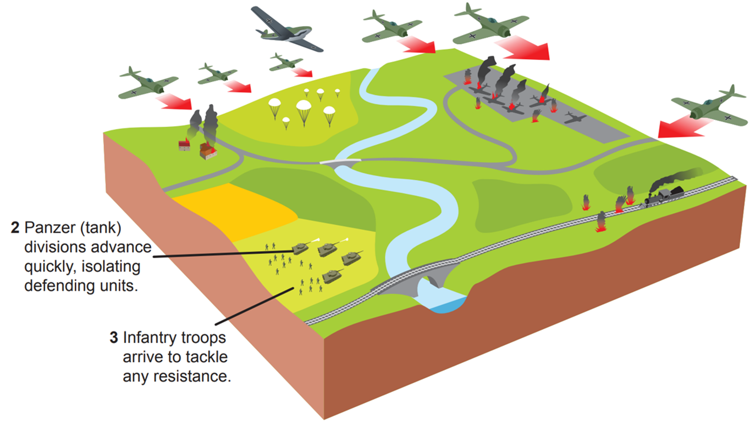
Strand Two & Three: The History of the World
Chapter Twenty-Five: World War II
Diagram taken from Artefact, 2nd Edition by Eimear Jenkinson and Gregg O'Neill (educate.ie)
@MsDoorley

Slide 30
The invasion of France
Britain and France expected Germany to attack the west and did very little to assist Poland. After World War I, the French had built the Maginot Line, a series of fortifications along the French-German border. For eight months, they and the British Expeditionary Force (BEF) faced the Germans, who waited behind their own fortification, the Siegfried Line. Since no fighting took place, this was nicknamed the Phoney War. Neville Chamberlain resigned as Prime Minister as he could no longer prevent war and was replaced by Winston Churchill.
On the 10th May 1940, the attack on Belgium, the Netherlands and France finally began, using Blitzkrieg tactics. The Germans avoided the Maginot Line by using Panzers to roll through the wooded, hilly terrain of the Ardennes, which the French had thought impossible to cross.
The BEF soldiers were pushed back to the coastal town of Dunkirk, where they became trapped. For nine days, over 900 boats were involved in the Allied evacuation of about 350,000 soldiers from the beaches at Dunkirk, also known as Operation Dynamo.
Strand Two & Three: The History of the World
Chapter Twenty-Five: World War II
@MsDoorley

Slide 31
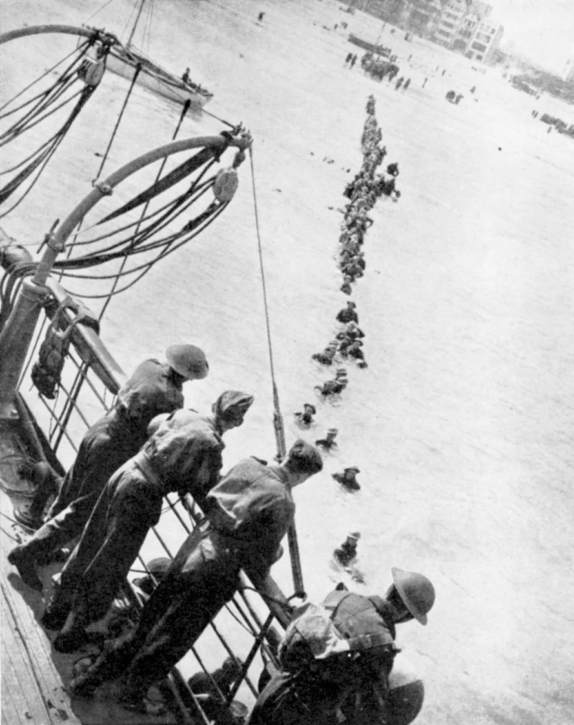
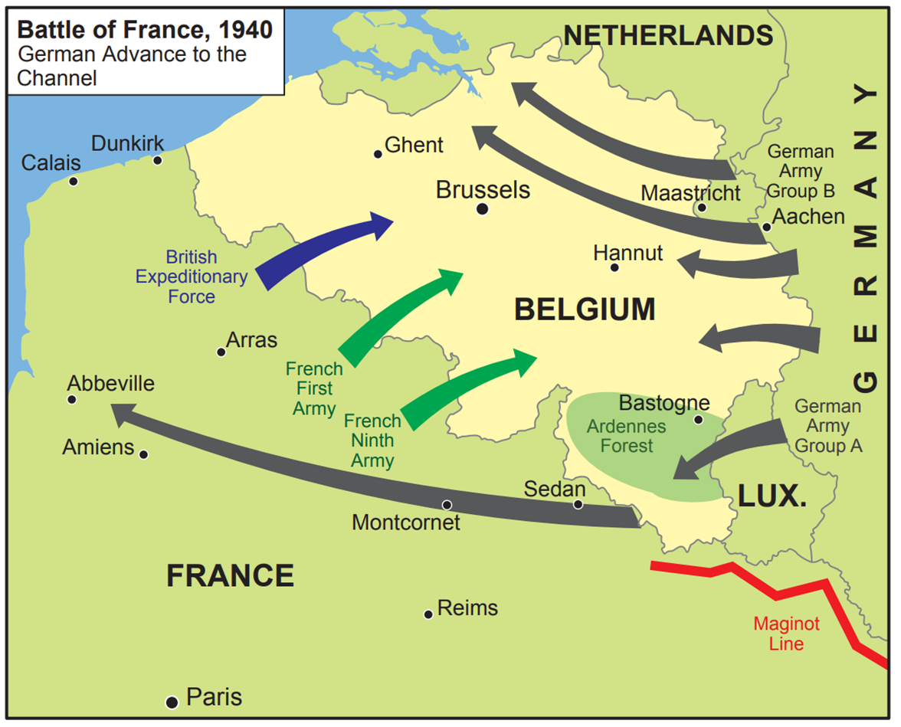
Circuit de
Spa-Francorchamps
Strand Two & Three: The History of the World
Chapter Twenty-Five: World War II
Diagram taken from Artefact, 2nd Edition by Eimear Jenkinson and Gregg O'Neill (educate.ie)
@MsDoorley

Slide 32
Checkpoint pg. 326 (Artefact, 2nd Edition)
  Explain the term Blitzkrieg
  How was Poland conquered so quickly?
  What was the Phoney War?
  What was the Maginot Line?
  Describe how Germany invaded France.
  What was Operation Dynamo?
Strand Two & Three: The History of the World
Chapter Twenty-Five: World War II
@MsDoorley

Slide 33
1939-1945
Chapter 25
24.2.2: THE BATTLE OF BRITAIN AND THE BLITZ
24.2.2: the battle of britain and the blitz
Strand Two: The History of Ireland
@MsDoorley

Slide 34
The Battle of Britain
Poland and France had both fallen to the Nazis. Of the Allied powers, only Britain remained. Hitler suggested peace talks, but Churchill refused.
Hitler planned a full invasion of Britain, codenamed Operation Sea Lion. He used submarines (U-boats) to attack shipping routes to Britain and to damage radar bases. The campaign of aerial attacks on Britain by the Luftwaffe became known as the Battle of Britain. On the first day, the 13th August 1940, 1,485 German bombers attacked Royal Air Forces (RAF) bases, including airfields and radar stations. These raids continued for a month. RAF pilots in Hurricanes and Spitfires were in constant dogfights (close combat between military aircraft) with the German ME 109s and ME 110s.
By mid-September 1940, the British had won the Battle of Britain. This was the first time Hitler had suffered a defeat. Some reasons for this were:
  The Germans moved their focus to London, which gave the RAF time to reorganise.
  Radar gave the British advance warning of German air raids.
  The British Spitfires were better than the German planes.
  German planes could not stay long in British airspace: they had to return to the Third Reich to refuel.
  German losses were greater: 1,700 Luftwaffe planes were shot down and nearly 3,500 airmen were killed or captured.
Strand Two & Three: The History of the World
Chapter Twenty-Five: World War II
@MsDoorley

Slide 35
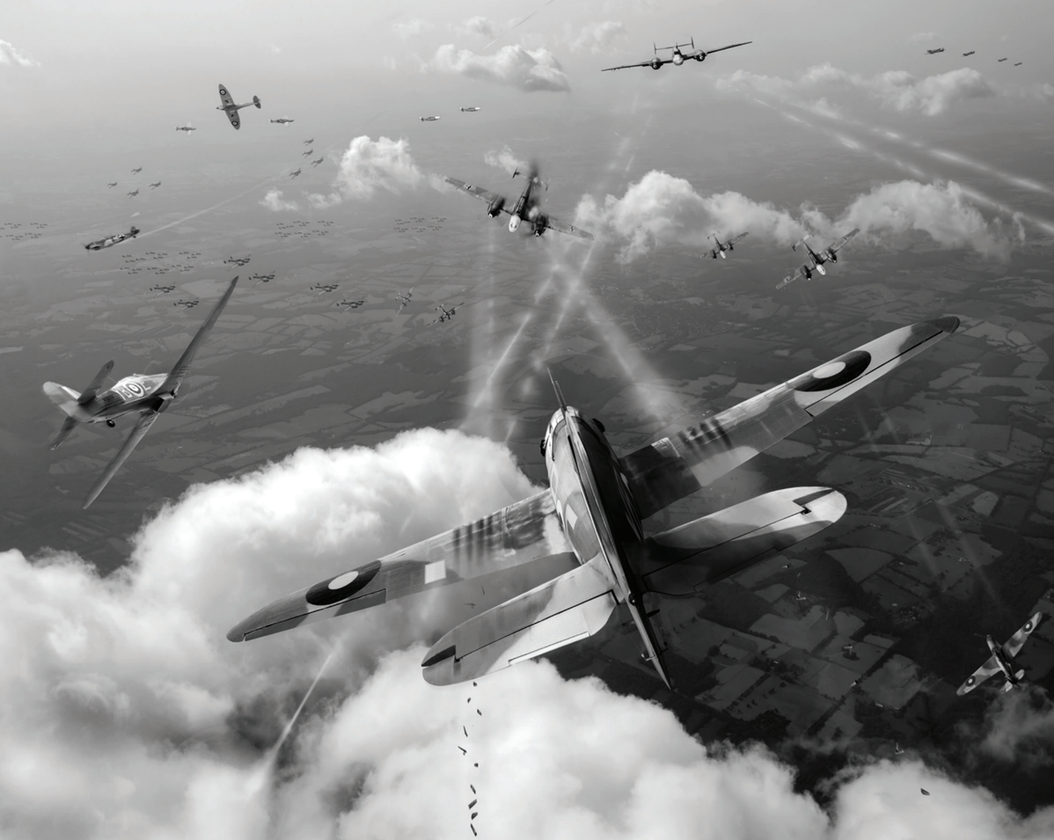
Strand Two & Three: The History of the World
Chapter Twenty-Five: World War II
Diagram taken from Artefact, 2nd Edition by Eimear Jenkinson and Gregg O'Neill (educate.ie)
@MsDoorley

Slide 36
Checkpoint pg. 238 (Artefact, 2nd Edition)
  What was Operation Sea Lion?
  Name the German and British aircraft used during the Battle of Britain.
  Give three reasons why Britain won the Battle of Britain.
Strand Two & Three: The History of the World
Chapter Twenty-Five: World War II
@MsDoorley

Slide 37
Checkpoint pg. 238 (Artefact, 2nd Edition)
  Operation Sea Lion was the planned invasion of Britain by Germany.
  German aircraft: ME 109s and ME110s; British aircraft: Hurricanes and Spitfires.
  Any three of: the Germans switched their focus to London, which gave the RAF time to reorganise; radar gave British advance warning of German air raids; Spitfires were better than the German planes; German planes could not stay long in British airspace before having to return to refuel; German losses (of planes and airmen) were greater.
Strand Two & Three: The History of the World
Chapter Twenty-Five: World War II
@MsDoorley

Slide 38
1939-1945
Chapter 25
25.3: THE TIDE OF WAR CHANGES
25.3: the tide of war changes
Strand Two: The History of Ireland
@MsDoorley

Slide 39
1939-1945
Chapter 25
25.3.1: OPERATION BARBAROSSA
25.3.1: operation barbarossa
Strand Two: The History of Ireland
@MsDoorley

Slide 40
Operation Barbarossa
Hitler wanted to expand the Third Reich's Lebensraum to the east - including the USSR, which was rich in resources such as oil. He also wanted to destroy communism. He expected to defeat the Red Army quickly. On the 22nd June 1941, Operation Barbarossa began. Germany invaded the Soviet Union in a rapid three-pronged attack towards the most important cities - Moscow, Leningrad and Kiev. Blitzkrieg tactics were very successful at first.
Having dismissed warnings, Stalin was shocked when Hitler invaded. Aided by propaganda, he called on his people to fight what was known as the Great Patriotic War against Germany. As it retreated, the Red Army used a scorched earth tactic, destroying anything useful to the enemy (such as crops, roads, bridges, railways and communication lines). Stalin also moved his factories further east so that the production of tanks and weapons could continue.
By the end of September, Kiev had fallen, Leningrad was under siege and the German army was approaching Moscow. However, conditions were incredibly tough. Heavy rain in October 1941 turned roads into seas of mud, making transport very difficult. Then as winter set in, the Germans discovered that they were not prepared for the extreme temperatures - as low as -40°C. Petrol froze and engines would not start. Many German soldiers froze to death. The Red Army seized this advantage to launch a counterattack that stopped the German army short of Moscow.
Strand Two & Three: The History of the World
Chapter Twenty-Five: World War II
@MsDoorley

Slide 41
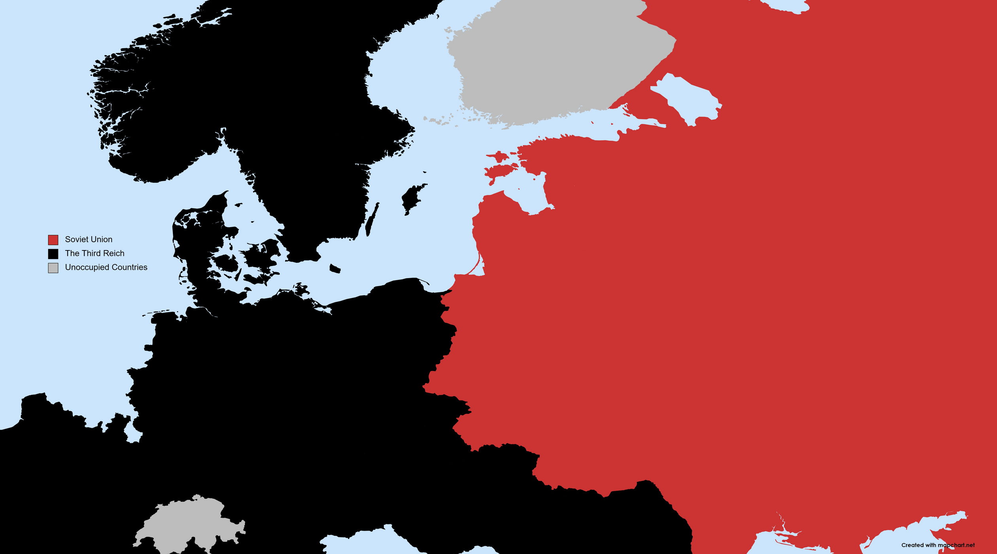
Finland
Norway
Sweden
Leningrad
Moscow
Strand Two & Three: The History of the World
Chapter Twenty-Five: World War II
Poland
Germany
Kiev
Slovakia
France
Switzerland
Hungary
Romania
@MsDoorley

Slide 42
The Battle of Stalingrad
In late summer 1942, the German forces that had taken Kiev advanced towards the oilfields of the Caucasus and the city of Stalingrad, led by General Paulus.
The city had been heavily bombed and large parts of it were in ruins. Rubble blocked the streets to tanks and snippers waited at windows. The Red Army was told to defend Stalingrad at all costs.
As the freezing winter of 1942-1943 set in, the Russians began to encircle the German Sixth Army to cut them off from their supplies. Russian supplies were being ferried in each night. On top of the deathly cold, the German forces began to starve. The Luftwaffe attempted to airdrop supplies, but only a fraction of what they needed reached the soldiers. Hitler denied General Paulus' request to retreat, insisting they continue to fight for Stalingrad 'to the last soldier and the last bullet'.
In February 1943, 91,000 starving, frozen and surrounded soldiers of the Sixth Army finally surrendered.
The exact number of casualties will never be known. However, it is estimated that over 800,000 Axis soldiers (German, Italian, Romanian or Hungarian) and 1.1 million Russians were either killed, wounded, missing or captured at Stalingrad. Many historians regard the Battle of Stalingrad as the main turning point of World War II.
Strand Two & Three: The History of the World
Chapter Twenty-Five: World War II
@MsDoorley

Slide 43
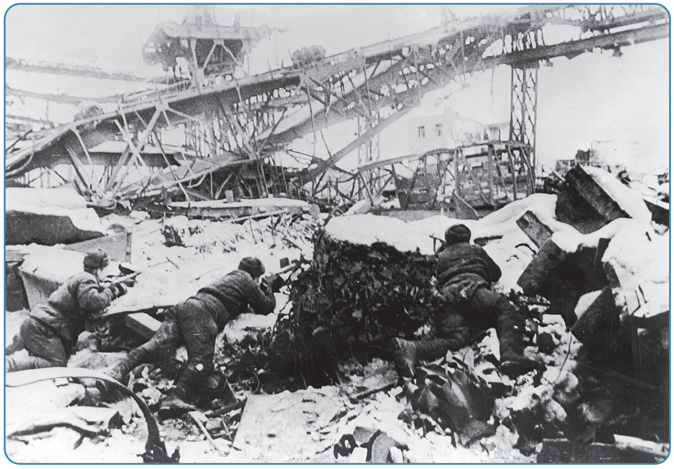
Strand Two & Three: The History of the World
Chapter Twenty-Five: World War II
Diagram taken from Artefact, 2nd Edition by Eimear Jenkinson and Gregg O'Neill (educate.ie)
@MsDoorley

Slide 44
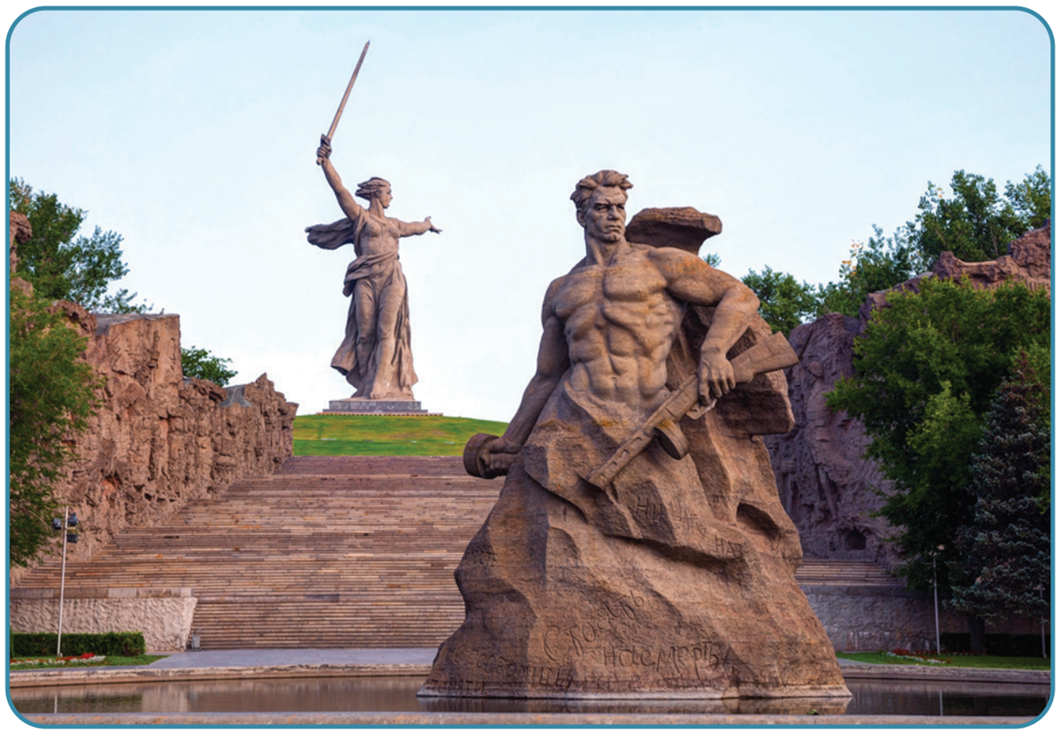
Strand Two & Three: The History of the World
Chapter Twenty-Five: World War II
Diagram taken from Artefact, 2nd Edition by Eimear Jenkinson and Gregg O'Neill (educate.ie)
@MsDoorley

Slide 45
Checkpoint pg. 330 (Artefact, 2nd Edition)
  Why did Hitler invade the USSR?
  What effect did the winter of 1941 have on the German invasion?
  Describe the Battle of Stalingrad.
  Why was the Battle of Stalingrad a major turning point in the war?
Strand Two & Three: The History of the World
Chapter Twenty-Five: World War II
@MsDoorley

Slide 46
Checkpoint pg. 330 (Artefact, 2nd Edition)
1. Hitler invaded the USSR because he wanted to expand his Lebensraum to the east; because Russia had been industrialising quickly and had oilfields; because he hated communism and wanted to destroy it; and because to Hitler the Slavic peoples (including Russians) were naturally inferior and should be defeated by Aryans.
2. The winter of 1941 had a disastrous effect on the German invasion. The Germans were not prepared for the extreme low temperatures and many froze to death. Petrol froze and engines wouldn’t start, and the better-equipped Soviet army counterattacked.
3. The Battle of Stalingrad began in the summer of 1942. German forces approached Stalingrad, while the Red Army was told to defend it at all costs. The German Sixth Army and the Red Army fought each other for each building. In the winter of 1942–1943, the Germans were cut off from supplies and began to starve. In February 1943, 91,000 Sixth Army soldiers surrendered.
4. It was a significant turning point because it was the first major defeat for the German forces on land, and showed that Hitler could be beaten, which inspired others.
Strand Two & Three: The History of the World
Chapter Twenty-Five: World War II
@MsDoorley

Slide 47
1939-1945
Chapter 25
25.3.2: WAR BEYOND EUROPE
25.3.2: war beyond europe
Strand Two: The History of Ireland
@MsDoorley

Slide 48
The USA enters World War II
Although the USA had provided the Allies with weapons and supplies, until 1941 it had officially remained neutral.
Japan had become an ally of Germany in 1936. Japan wanted to gain territory and resources in eastern Asia and the Pacific Ocean - but the USA had obstructed this. On the 7th December 1941, Japan attempted to destroy the entire US Pacific Fleet at Pearl Harbour in Hawaii. In just two hours, 3,000 people were killed. Japan and the USA were immediately at war.
Within four days, Japan's Axis partners - Germany and Italy - had declared war on the USA. President Franklin D. Roosevelt agreed to send troops and weapons to help fight the Axis powers in Europe and North Africa. He agreed with Churchill that defeating Hitler should be the top priority.
Strand Two & Three: The History of the World
Chapter Twenty-Five: World War II
@MsDoorley

Slide 49
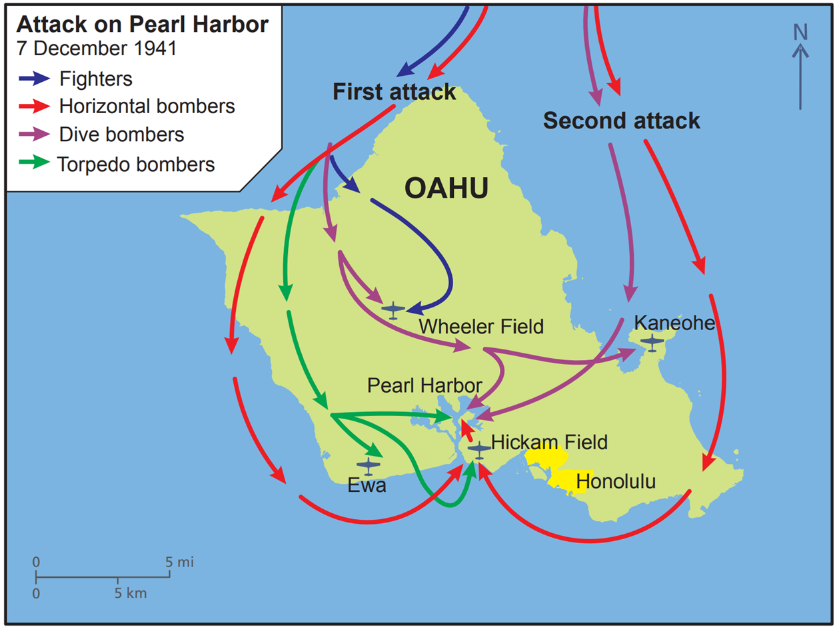
Strand Two & Three: The History of the World
Chapter Twenty-Five: World War II
Diagram taken from Artefact, 2nd Edition by Eimear Jenkinson and Gregg O'Neill (educate.ie)
@MsDoorley

Slide 50
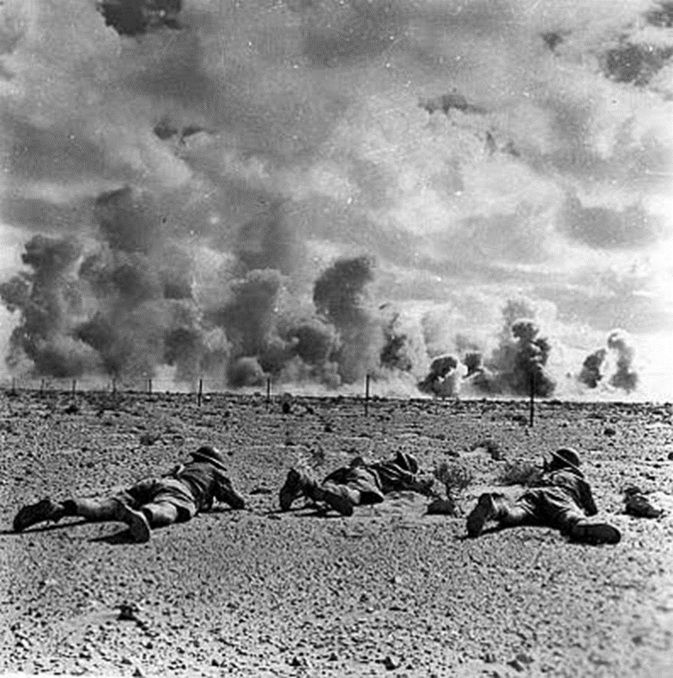
War in the Mediterranean
The second major battle which swung the tide of the war in favour of the Allies was the Battle of El Alamein in Egypt. German General Rommel had driven the British back into Egypt in North Africa but he was short of men because of the Russian front.
In October 1942 British General Montgomery stopped Rommel and captured 30,000 German and Italian troops at the Battle of El Alamein. Montgomery’s 8th army (the desert rats) drove the Germans across the Sahara desert. General Eisenhower and U.S. troops landed on the North West coast of Africa.
By January 1943 the German/Italian force was trapped in Tunisia and escaped through Itlay.
Strand Two & Three: The History of the World
Chapter Twenty-Five: World War II
Diagram taken from Artefact, 2nd Edition by Eimear Jenkinson and Gregg O'Neill (educate.ie)
@MsDoorley

Slide 51
Italy Exits The War
After the German /Italian exit from North Africa, British and U.S. forces invaded Italy from Sicily in the South. The Italian resistance overthrew Mussolini and surrendered to the allies. Hitler rescued Mussolini and persuaded him to regain control but he was captured again and shot in 1945. German forces were driven North out of Italy between 1943 and 1945.
Strand Two & Three: The History of the World
Chapter Twenty-Five: World War II
@MsDoorley

Slide 52
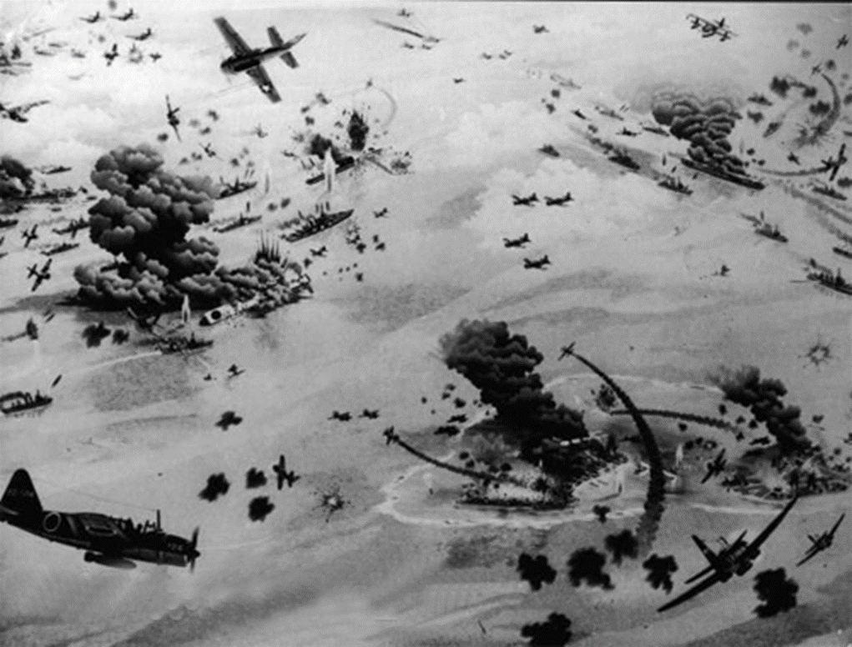
The Battle of Midway
Japanese and U.S. forces fought a war at sea and in the air. American air attacks on Japanese ships sank 4 aircraft carriers and shot down over 300 planes. This turned the tide in the pacific and Japan lost control there. They were driven out over the next 3 years by British and U.S. forces.
Strand Two & Three: The History of the World
Chapter Twenty-Five: World War II
Diagram taken from Artefact, 2nd Edition by Eimear Jenkinson and Gregg O'Neill (educate.ie)
@MsDoorley

Slide 53
The Battle of the Atlantic
The USA had sent food and military supplies to Britain across the Atlantic Ocean since the outbreak of the war. In just six months in 1940, German U-boats (submarines) sank over 3 million tonnes of Allied shipping, with great loss of life. From 1941, the US navy shared the guarding of the Atlantic shipping.
New radar and sonar technology helped, as did the evolving art of codebreaking. The German navy used the Enigma code to communicate with its U-boats; once this code was cracked, Allied Ships knew where the U-boats would be and could avoid or attack them.
Strand Two & Three: The History of the World
Chapter Twenty-Five: World War II
Did You Know?
The British government recruited mathematicians, translators, chess players and people gifted at solving cryptic crosswords to do top-secret work as codebreakers. At Bletchley Park outside London, the mathematician Alan Turning led a team which designed a machine to help decipher the Enigma Code. By early 1945, some 10,000 people worked there (75% were women) reading up to 4,000 coded messages a day.
@MsDoorley

Slide 54
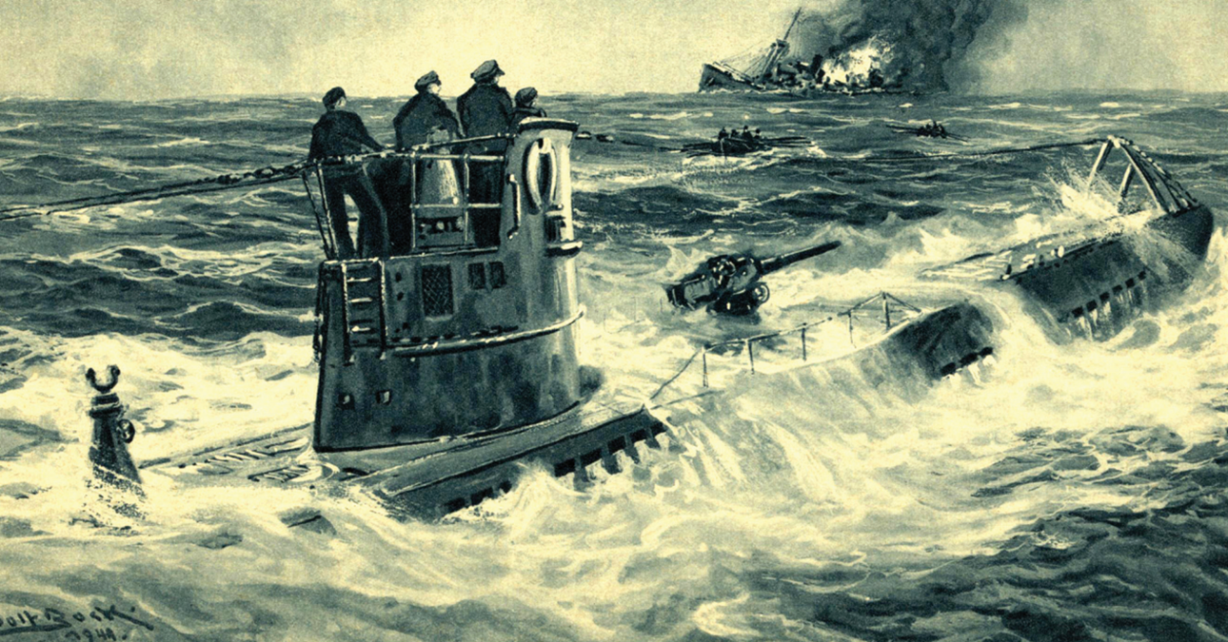
Strand Two & Three: The History of the World
Chapter Twenty-Five: World War II
Diagram taken from Artefact, 2nd Edition by Eimear Jenkinson and Gregg O'Neill (educate.ie)
@MsDoorley

Slide 55
Checkpoint pg. 331 (Artefact, 2nd Edition)
  What happened at Pearl Harbour and what effect did it have?
  Who was the US President at this time?
  What was the Battle of the Atlantic?
  What was the impact of the USA entering the war?
Strand Two & Three: The History of the World
Chapter Twenty-Five: World War II
@MsDoorley

Slide 56
D-Day
Stalin needed Churchill and Roosevelt to attack from the west to ease the pressure on the Red Army. In Operation Overlord, over 150,000 US, British and Canadian troops would land in Normandy, France - but they fed the Germans false plans that they were to land further east, at Calais. The five beaches were given codenames: Utah, Omaha, Juno, Gold and Sword. General Eisenhower led the largest seaborne invasion in history, with over 7,000 ships and landing craft, on the 6th June 1944, now known as D-Day or Deliverance Day.
Most of Germany's troops were stationed at Calais. The Allies landed around 156,000 troops to the west while 10,000 planes protected them from overhead. They broke down German defences on the beaches, built artificial harbours to bring in tanks and trucks and established a pipeline for fuel. By August, the Allies had stopped the Germans at Falaise, and Paris was liberated on 25th August.
Strand Two & Three: The History of the World
Chapter Twenty-Five: World War II
@MsDoorley

Slide 57
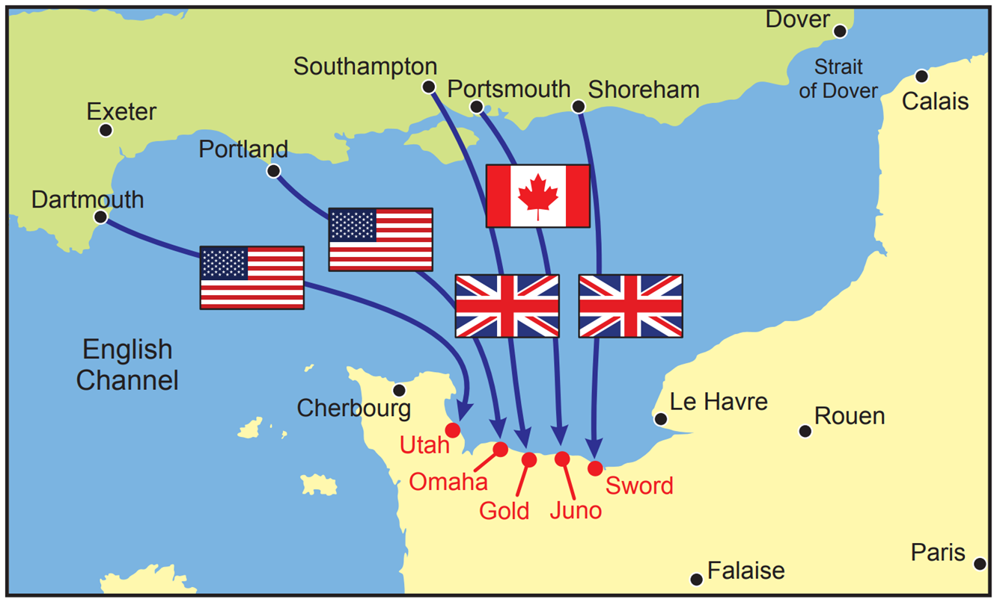
Strand Two & Three: The History of the World
Chapter Twenty-Five: World War II
Diagram taken from Artefact, 2nd Edition by Eimear Jenkinson and Gregg O'Neill (educate.ie)
@MsDoorley

Slide 58
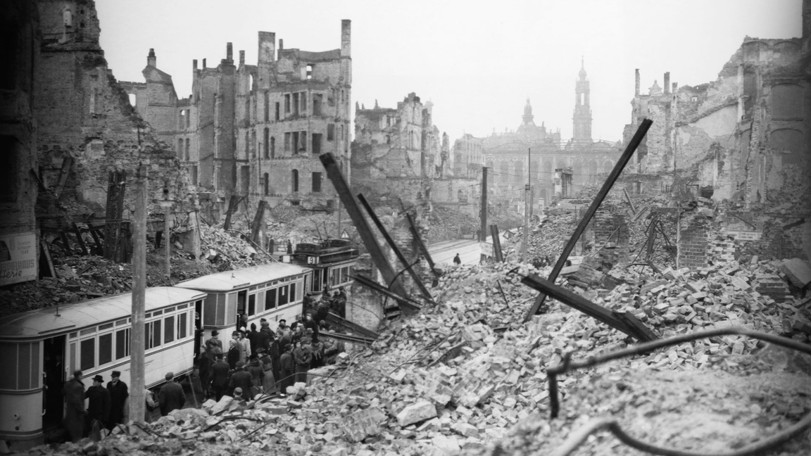
Air Raids on Germany
The Allies bombed Germany by day and night, targeting the large cities such as Hamburg and Berlin and also the industrial centre in the Ruhr Valley, to damage war production.
Dresden underwent some of the worst bombing. In four raids between 13th - 15th February 1945, over 3,900 tonnes of high-explosive bombs and incendiary (fire-starting) devices were dropped on the city by the RAF and the US Army Air Forces (USAAF), causing an immense firestorm. About 25,000 people died, most of whom were civilians.
Strand Two & Three: The History of the World
Chapter Twenty-Five: World War II
Diagram taken from Artefact, 2nd Edition by Eimear Jenkinson and Gregg O'Neill (educate.ie)
@MsDoorley

Slide 59
Checkpoint pg. 333 (Artefact, 2nd Edition)
  Explain the term Operation Overlord.
  Describe the D-Day landings. Why were they successful?
  What effect did the bombings have on Germany?
Strand Two & Three: The History of the World
Chapter Twenty-Five: World War II
@MsDoorley

Slide 60
Checkpoint pg. 333 (Artefact, 2nd Edition)
  Operation Overlord: the codename for the landing of roughly 156,000 US, British and Canadian troops on five beaches in Normandy, France on D-Day.
  The D-Day landings took place as part of Operation Overlord on 6 June 1944, when over 7,000 ships and landing craft invaded France, landing on five beaches codenamed Utah, Omaha, Juno, Gold and Sword. The landings were a success because most of the German troops were stationed in Calais where they thought the invasion was going to happen.
  The bombings damaged Germany’s war production and killed a large number of civilians, including almost 25,000 in Dresden alone in an immense firestorm.
Strand Two & Three: The History of the World
Chapter Twenty-Five: World War II
@MsDoorley

Slide 61
1939-1945
Chapter 25
25.4: LIFE IN WARTIME BRITAIN AND OCCUPIED FRANCE
25.4: life in wartime britain and occupied france
Strand Two: The History of Ireland
@MsDoorley

Slide 62
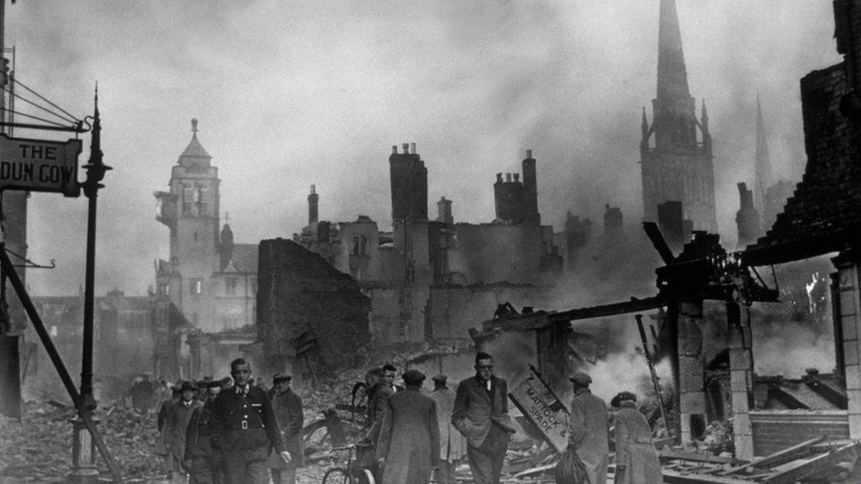
The Blitz
After the Battle of Britain, the Luftwaffe switched its strategy to one of bombing British cities at night-time; this was the Blitz. It took place between September 1940 and May 1941. During the Blitz, Germany dropped explosive and incendiary bombs on London and other cities. Hitler's main targets were ports, power stations and factories. Britain used anti-aircraft guns to defend its cities.
The air raids killed 43,000 civilians and lasted for eight months. One infamous example was Coventry on the 14th November 1940, when 500 German bombers dropped 5000 tonnes of high explosives and nearly 900 bombs in ten hours of relentless bombing.
Strand Two & Three: The History of the World
Chapter Twenty-Five: World War II
Diagram taken from Artefact, 2nd Edition by Eimear Jenkinson and Gregg O'Neill (educate.ie)
@MsDoorley

Slide 63
Life in wartime Britain
Thousands of homes were destroyed in the air raids. Whenever warning sirens were heard, people took shelter. Up to 130,000 slept in the London Underground stations. Children from the cities were sent to stay with families in the countryside, where it was safer: this was known as evacuation.
Approximately seven million women entered the workforce during World War II. On farms, in factories and on the railways, canals and buses, women filled roles that had been left vacant when men went to war. In addition, women worked in wartime industries such as munitions and aircraft factories and in the armed forces, carrying out clerical duties and vehicle repairs.
Before the war, Britain had imported two-thirds of its food supplies. Now merchant ships were under attack by U-boats. Foods such as sugar, butter and bacon became rare and ration books were introduced for every citizen. By 1942, tea, milk, eggs and cheese were also rationed. A campaign called 'Dig for Victory' encouraged people to grow their own food on any available land.
Strand Two & Three: The History of the World
Chapter Twenty-Five: World War II
@MsDoorley

Slide 64
The occupation of France
While Operation Dynamo was taking place, the French forces collapsed as the Germans advanced. Italy declared war on France while German forces entered Paris unopposed on 14th June 1940.
Germany occupied the northern half of France. In the unoccupied 'free zone', a puppet government controlled by the Nazis was set up in the town of Vichy with the elderly Philippe Pétain as leader. This regime, known as Vichy France, was very conservative and cooperated with the Nazis' anti-Semitic policies.
Strand Two & Three: The History of the World
Chapter Twenty-Five: World War II
@MsDoorley

Slide 65
Life in occupied France
By the time German forces arrived in Paris, two-thirds of Parisians (particularly those in the wealthier neighbourhoods) had fled to the countryside and the south of France. For those who remained, the occupation was a very tough life. The French press and radio issued only German propaganda. A curfew was in effect from 9pm until 5am; at night, the city went dark.
From September 1940 rationing began of items such as food, tobacco, coal and clothing. Another million Parisians left for the provinces, where there was more food and fewer Germans. The Germans transformed French industry and agriculture to ensure that shipments to Germany had first priority. What was left then want to Paris and lastly, to the rest of France. For example, all the trucks manufactured at the Citroën factory went directly to Germany, as did most shipments of meat, wheat, milk and other agricultural products. Due to fuel shortages, the number of automobiles on the Paris streets dropped from 350,000 to about 4,500. Every year the supplies grew more scarce and the prices became higher for the French.
Jewish people were discriminated against and forced to wear the yellow Star of David, as in countries such as Germany and Poland. Jews were even banned from main streets, movie theatres, libraries, parks, gardens, restaurants, cafés and other public places, and were required to ride on the last car of metro trains.
The French Resistance was a combination of communists and other groups who joined forces to fight the Nazi occupation. They gathered intelligence, sheltered Allied prisoners of war (POWs) and sabotaged the German war effort. For example, ahead of the D-Day landings, the French Resistance helped to destroy roads and bridges and cut communication lines, which hindered the German response.
Strand Two & Three: The History of the World
Chapter Twenty-Five: World War II
@MsDoorley

Slide 66
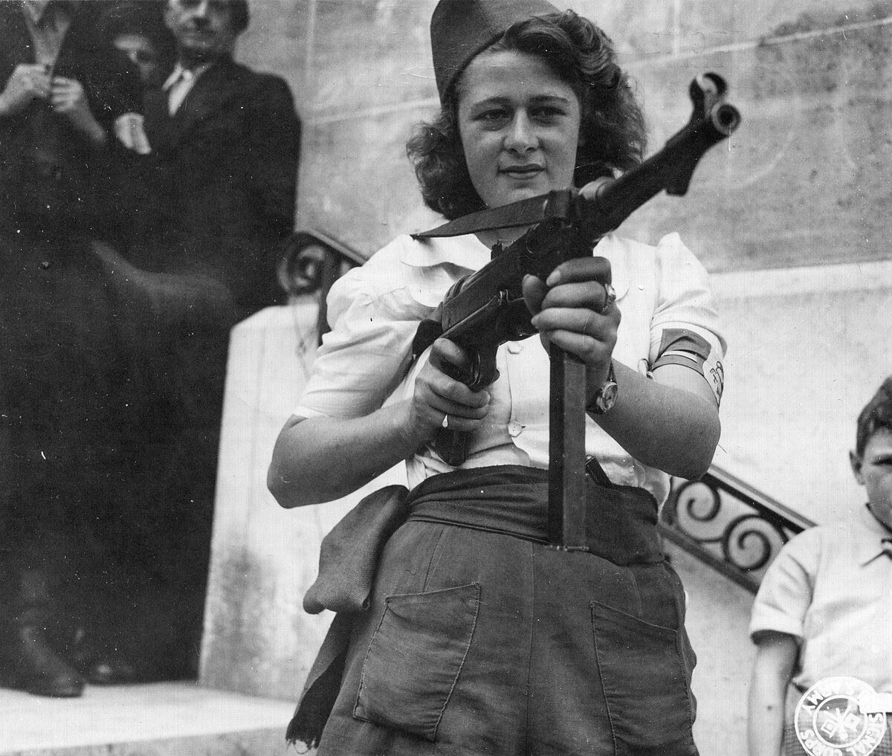
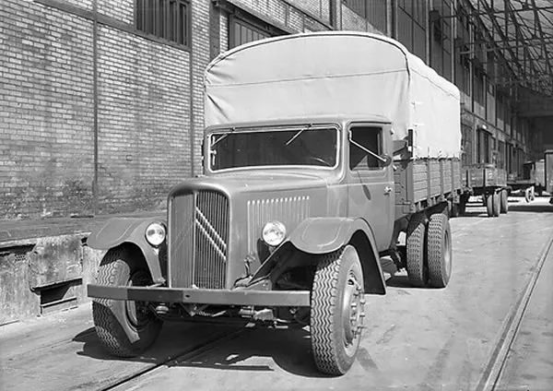
Strand Two & Three: The History of the World
Chapter Twenty-Five: World War II
Did You Know?
Pierre-Jules Boulanger, the chairperson of Citroën at this time, instructed workers to build the trucks that the Nazis demanded, but to set the oil level indicator a little higher than it should be. This was so that it would show more oil than the vehicle really contained and their trucks would constantly break down, leaving the Germans stranded.
Diagram taken from Artefact, 2nd Edition by Eimear Jenkinson and Gregg O'Neill (educate.ie)
@MsDoorley

Slide 67
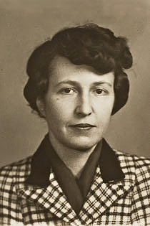
Marie-Hélène Lefaucheux, 1904-1964
Marie-Hélène Lefaucheux was born in Paris. She was one of the first women to study at the Paris Institute of Political Studies. During World War II, Lefaucheux and her husband Pierre became members of the French Resistance. Their apartment became the headquarters of an organisation that prepared packages for political prisoners and passed on information to their families. Marie-Hélène served as Vice President of the Paris branch of the French Committee of National Liberation. In 1944, Pierre was arrested and deported. Marie-Hélène followed his train on her bicycle and convinced a regional Gestapo leader to transfer Pierre from Buchenwald concentration camp to Eastern France.
After the war, Marie-Hélène won several awards for her work in the Resistance. She was elected to the Constituent Assembly of the Provisional Government of the French Republic. In 1946, she was the only woman in the French delegation at the first session of the United Nations General Assembly. She worked to promote human rights, filling positions such as as President of the National Council of French Women (1954-1964) and President of the International Council of Women in 1957. She died in a plane crash in 1964.
Strand Two & Three: The History of the World
Chapter Twenty-Five: World War II
@MsDoorley

Slide 68
Checkpoint pg. 336 (Artefact, 2nd Edition)
  Explain the term the Blitz.
  Describe what life was life for people living in wartime Britain.
  What was Vichy France?
  Describe what life was life for people living in occupied France.
Strand Two & Three: The History of the World
Chapter Twenty-Five: World War II
@MsDoorley

Slide 69
1939-1945
Chapter 25
25.5: THE END OF THE WAR AND ITS LEGACY
25.5: the end of the war and its legacy
Strand Two: The History of Ireland
@MsDoorley

Slide 70
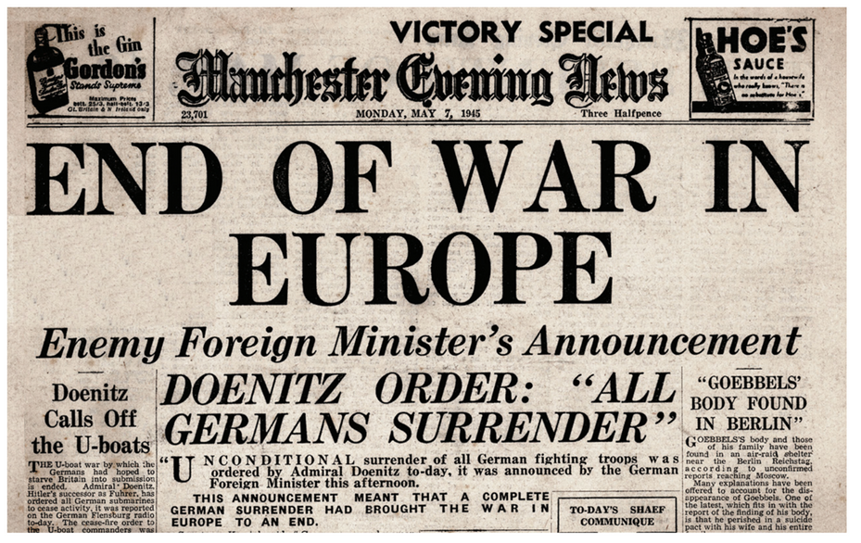
The end of World War II
By 1945, major German cities such as Berlin and Dresden had been destroyed. German soldiers were still fighting but were unable to halt the Russian and Allied troops. The Allies took Paris and continued from the West while Russian troops advanced from the East.
Hitler made one last stand in Eastern France with the Battle of the Bulge but this too failed to halt the Allied advances. In March 1945, the Allies crossed the River Rhine in Western Germany.
The USSR began to attack Berlin. Hitler and his wife Eva Braun committed suicide on the 30th April 1945 in his bunker when the Red Army was just streets away. He was succeeded by Admiral Dönitz, who surrendered. Victory in Europe Day (VE Day) is celebrated on the 8th May 1945.
Strand Two & Three: The History of the World
Chapter Twenty-Five: World War II
Diagram taken from Artefact, 2nd Edition by Eimear Jenkinson and Gregg O'Neill (educate.ie)
@MsDoorley

Slide 71
The end of World War II
Reasons why the Allies were victorious
The alliance of the 'Big Three' - Britain, the US and the USSR - meant they had more troops, weapons and equipment.
Germany was weakened as it was fighting a two-front war.
The Allies gained control of the air.
The Red Army defeated the Germany army on land.
Hitler sacked many of his advisors and interfered too much in Germany's military tactics.
Strand Two & Three: The History of the World
Chapter Twenty-Five: World War II
Diagram taken from Artefact, 2nd Edition by Eimear Jenkinson and Gregg O'Neill (educate.ie)
@MsDoorley

Slide 72
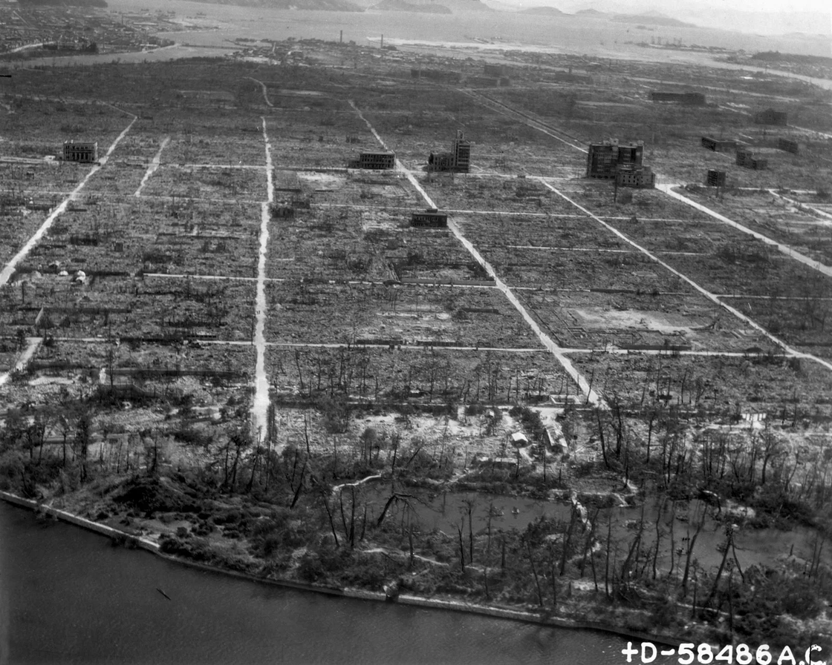
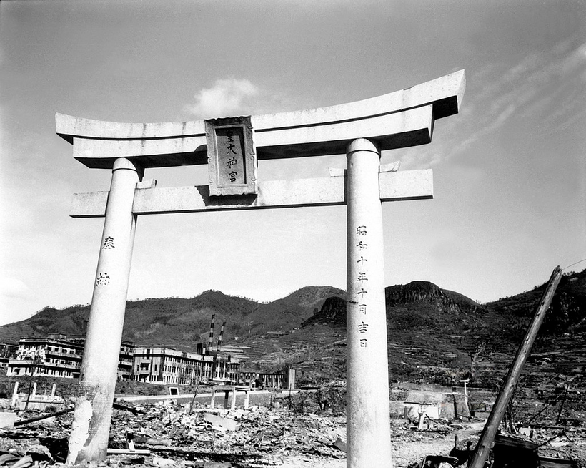
The Atomic Bombings of Japan
Japanese Kamikaze pilots continued bombing US aircraft carriers and killing US troops in their thousands. President Roosevelt died on the 12th April 1945 and was replaced by Harry Truman who decided to attack Japan to force their surrender. On the 6th August 1945 the first Atomic Bomb was dropped on the city of Hiroshima, killing 80,000 people. Three days later another was dropped on Nagasaki, killing 40,000 (thousands more would die later from radiation poisoning). Japan surrendered on the 15th August 1945, now known as Victory over Japan Day.
Strand Two & Three: The History of the World
Chapter Twenty-Five: World War II
Diagram taken from Artefact, 2nd Edition by Eimear Jenkinson and Gregg O'Neill (educate.ie)
@MsDoorley

Slide 73
The impact of World War II
World War II had both immediate and long term consequences.
  Fighting no longer had to be confined to particular areas, as in World War I. The new technology was highly mobile and so units and 'fronts' could move very rapidly.
  War came to civilian populations in a way it never had before. While an estimated 7 million civilians died in World War I, this was dwarfed by the estimated 38-55 million civilian deaths of World War II.
  The technological advances by countries such as Britain and the USA made all the difference in their eventual defeat of the Axis powers. However, the destructive power of this technology was far greater than ever before: while World War I cost 10 million soldiers their lives, roughly 15-20 million soldiers died in World War II.
  In total, over 60 million people died in World War II. As we have learned, most of those killed were civilians. Roughly 40 million more were displaced inside their own country or became refugees elsewhere. Many survivors had seen their homes destroyed, gone hungry, lost loved ones, or experienced terror and violence.
Strand Two & Three: The History of the World
Chapter Twenty-Five: World War II
@MsDoorley

Slide 74
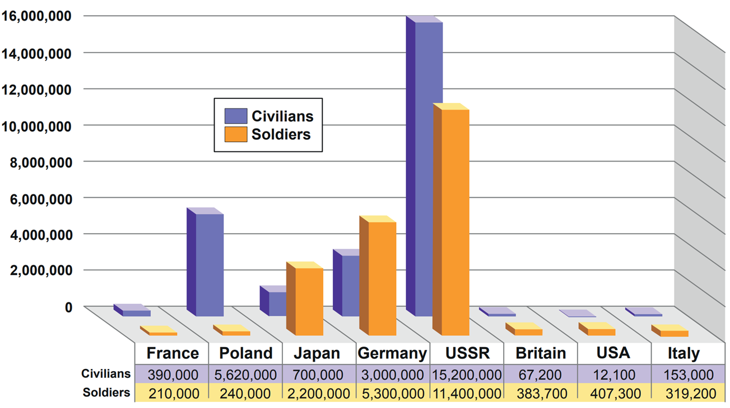
Strand Two & Three: The History of the World
Chapter Twenty-Five: World War II
Diagram taken from Artefact, 2nd Edition by Eimear Jenkinson and Gregg O'Neill (educate.ie)
@MsDoorley

Slide 75
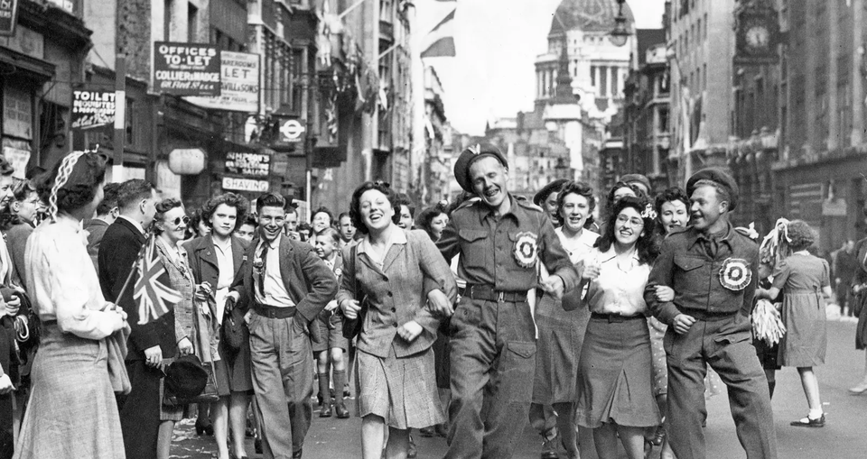
The impact of World War II
  Many cities, such as Coventry, Warsaw, Dresden and Leningrad, were destroyed by bombing. Whole industries, vast areas of farmland, roads, railways, communication lines and so forth also had to be rebuilt.
  The countries of Central and Eastern Europe came under USSR control and became communist.
  Trials of Nazi war criminals took place in Nuremberg; some were executed.
  The USA and the USSR were now the two most powerful countries, also known as superpowers, in the world. Tensions between the two developed into the Cold War.
  Britain and France were weak after the war. Their colonies began to demand independence.
  The United Nations was established in 1945 to prevent another war. It replaced the League of Nations.
  The EEC was set up in 1957 to encourage greater closeness and cooperation between European states.
Strand Two & Three: The History of the World
Chapter Twenty-Five: World War II
Diagram taken from Artefact, 2nd Edition by Eimear Jenkinson and Gregg O'Neill (educate.ie)
@MsDoorley

Slide 76
Immediate Impact | Long-Term Impact
Estimate 38-55 million civilian deaths | The countries of Central and Eastern Europe came under USSR control and became communist.
15-20 million soldiers died in World War II. | The USA and the USSR were now the two most powerful countries in the world.
Roughly 40 million people were displaced inside their own country or became refugees elsewhere. | Tensions between the US and USSR developed into the Cold War.
Numerous cities were destroyed. | Britain and France were weak after the war.
Whole industries, vast areas of farmland, roads, railways, communication lines and so forth also had to be rebuilt. | Colonies began to demand independence.
Homes were destroyed; people went hungry, lost loved ones and/or experienced terror and violence. | In 1945, the United Nations was established.
Trials of Nazi war criminals took place in Nuremberg. | In 1957, the EEC was set up.
Strand Two & Three: The History of the World
Chapter Twenty-Five: World War II
Diagram taken from Artefact, 2nd Edition by Eimear Jenkinson and Gregg O'Neill (educate.ie)
@MsDoorley

Slide 77
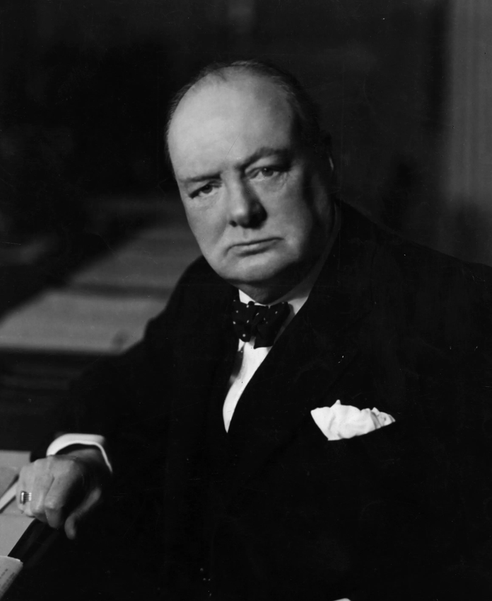
Winston Churchill, 1874-1965
Winston Churchill was born at Blenheim Palace, England. He served in the British army until 1899 and then became a war correspondent. He published books on his experiences in Africa. In 1900, aged 26, Churchill was elected as a Conservative MP. However, four hears later he 'crossed the floor' and joined the Liberal Party. Leading up to World War I, he was the First Lord of the Admiralty. Churchill was one of the key figures who planned the failed Gallipoli campaign in 1915. He was on the British team during the Anglo-Irish Treaty 1921 negotiations and afterwards was supportive of the new Irish government. In 1924, he rejoined the Conservative Party and served as Chancellor of the Exchequer until 1929. Churchill was opposed to Home Rule in India and also to appeasement, which made him unpopular for a period of time. When World War II broke out, he was reappointed as First Lord of the Admiralty. When Chamberlain resigned, Churchill replaced him as Prime Minister until 1945. During World War II, he formed a strong relationship with President Franklin Roosevelt. Churchill's rousing speeches inspired the British people, especially during the Blitz in 1940 and 1941. After the war, he became a strong critic of Stalin. Church was Prime Minister again from 1951 to 1955. He won the Nobel Prize for Literature in 1953 and died in 1965 at the age of 90.
Strand Two & Three: The History of the World
Chapter Twenty-Five: World War II
Diagram taken from Artefact, 2nd Edition by Eimear Jenkinson and Gregg O'Neill (educate.ie)
@MsDoorley

Slide 78
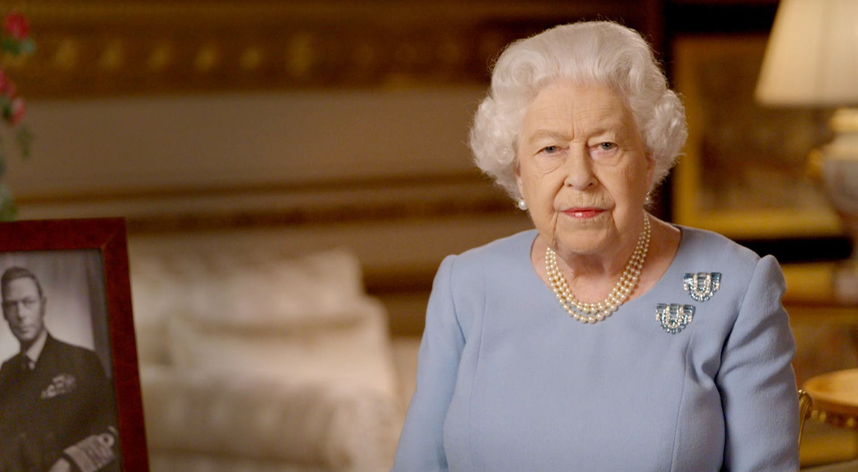
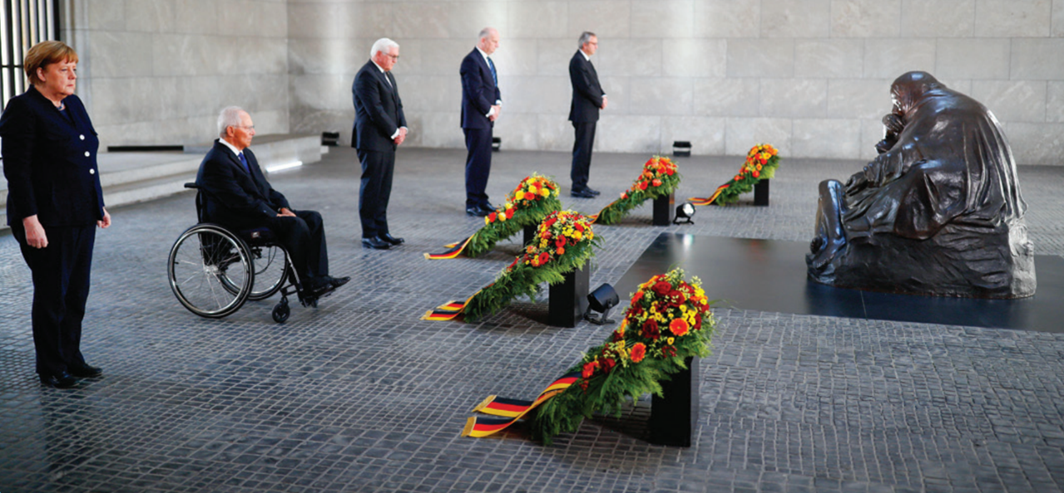





Commemorating World War II
On the 8th May 2020, leaders across Europe commemorated the 75th Anniversary of Victory in Europe Day. The then leaders of France and Germany, President Emmanuel Macron and Chancellor Angela Merkel, laid wreaths at small ceremonies, while the UK held a two-minute silence, and later an address by Queen Elizabeth II was broadcast. Other events were also held, but the commemorations were limited due to coronavirus lockdowns across Europe.
Strand One: The Nature of History
Chapter Twenty-Five: World War II
Diagram taken from Artefact, 2nd Edition by Eimear Jenkinson and Gregg O'Neill (educate.ie)
@MsDoorley

Slide 79
Checkpoint pg. 340 (Artefact, 2nd Edition)
  How did World War II draw to an end?
  Why did the Allies win the war?
  Look at the graph on pg 338. What was the portion of civilian to military deaths in (a) Poland and (b) the USSR? Which country had the highest casualties?
  How did World War II impact on (a) Germany; (b) Europe; (c) the US and USSR; (d) the wider world?
  Explain two immediate impacts and two long-term impacts of World War II.
Strand Two & Three: The History of the World
Chapter Twenty-Five: World War II
@MsDoorley

Slide 80
1939-1945
Chapter 25
25.6: TECHNOGICAL CHANGE - A NEW KIND OF WAR
25.6: technogical change - a new kind of war
Strand Two: The History of Ireland
@MsDoorley

Slide 81
Advances in Wartime Technology
Both the Allied and Axis powers created, then refined, new weapons and technology to gain an advantage over their enemies.
At Sea
On Land
  Better submarines and torpedoes were developed and research went into anti-submarine technology - most importantly ASCID (sonar) and radar, so that ships could scan the ocean for hidden threats.
  Aircraft carriers helped to control the seas. They were seagoing air bases with a flight deck and facilities for carrying, arming, deploying and recovering aircraft.
  By now, tanks were an important part of warfare. Germany had developed various Panzer tanks had in defiance of the Treaty of Versailles ban. The heavily armoured Tiger tank weighed 54 tonnes, had an 8.8 cm gun and had a top speed of 45 km/h. The Allies developed dummy tanks to trick the Germans, as well as amphibious tanks, which were capable of crossing water.
  Improvements were also made to grenades, pistols, rifles and machine guns. The Germans invented a machine gun called the MG 42 that could fire 1,200 rounds per minute.
Strand Two & Three: The History of the World
Chapter Twenty-Five: World War II
@MsDoorley

Slide 82
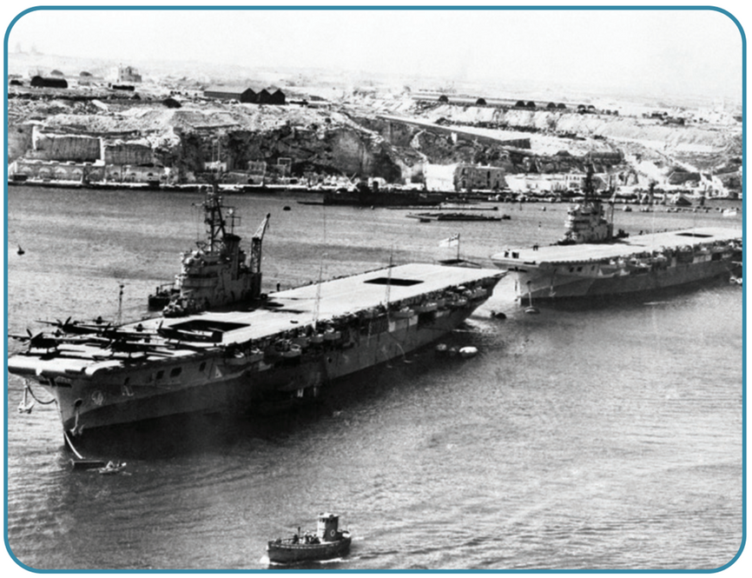
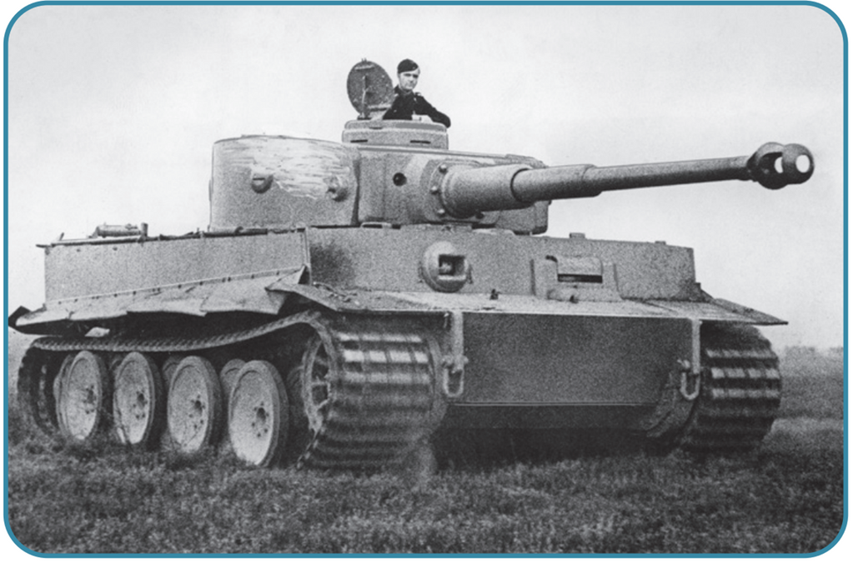
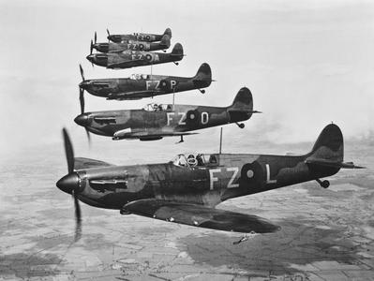
Strand Two & Three: The History of the World
Chapter Twenty-Five: World War II
Diagram taken from Artefact, 2nd Edition by Eimear Jenkinson and Gregg O'Neill (educate.ie)
@MsDoorley

Slide 83
Advances in Wartime Technology
In The Air
The Atomic Bomb
  The British developed the Hurricane and Spitfire aircraft which were powered by Rolls Royce engines. The Americans had developed a long range bomber, the B-29 Superfortress, in 1942. In 1944, the Germans developed the first jet fighter, the Messerschmitt ME 262.
  Long range rockets were also developed by the German scientists. The V-1 was the first flying rocket. It flew at speeds of 400km/h. The V-2 flew at supersonic speed, which a top speed of 5,760km/h.
  The US feared the Germans would be the first to develop the atomic bomb, so it began an intensive research programme codenamed the Manhattan Project, led by J. Roberts Oppenheimer, a Jewish nuclear physicist. The first working atomic bomb was tested in the New Mexico desert during the Trinity Test on the 16th July 1945. Less than a month later, the US Air Force dropped two atomic bombs on Japanese cities of Hiroshima and Nagasaki, killing 129,000 civilians.
Strand Two & Three: The History of the World
Chapter Twenty-Five: World War II
Did You Know?
Albert Einstein's only involvement in the development of the atomic bomb was a letter urging the USA to research it, warning that the Germans had the potential to develop one themselves. Oppenheimer himself was educated in Germany about nuclear physics alongside scientists who would work on nuclear physics for the Nazis during World War II.
@MsDoorley

Slide 84
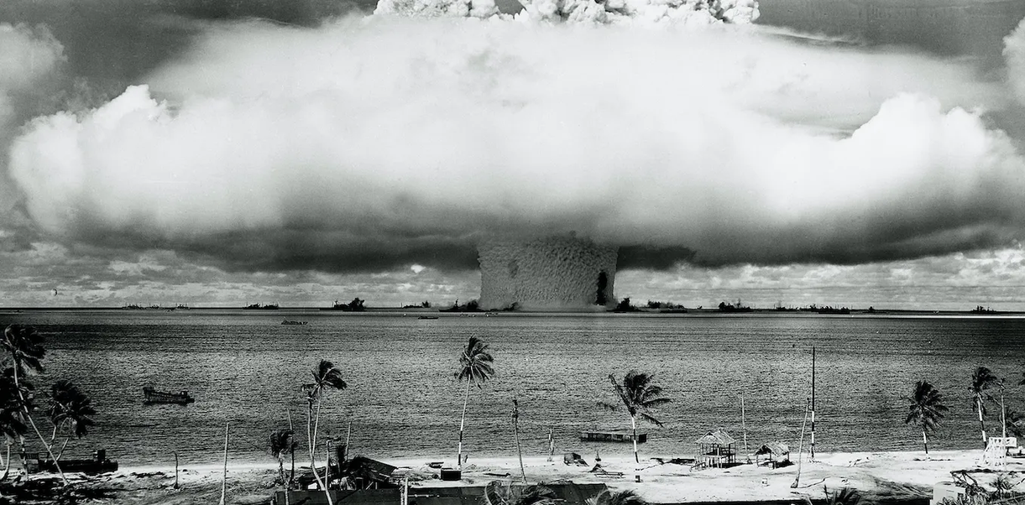
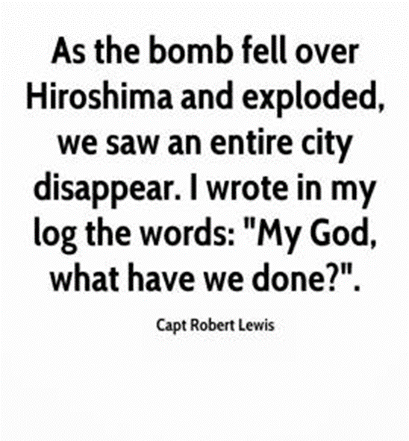
Strand Two & Three: The History of the World
Chapter Twenty-Five: World War II
Did You Know?
Many of the leading nuclear physicists at the time of World War II were Jewish. Under Nazi occupation, many of these fled to the US and would later become involved in the development of the Atomic Bomb. Jewish physicists who worked on the Manhattan Project include Oppenheimer, Edward Teller, Robert Serber, Charlotte Serber, George Placzek, Joseph Rotblat, John von Neumann and Jay Wechsler.
Oppenheimer would meet Werner Karl Heisenberg, the leading Nazi nuclear physicist during his time studying nuclear physics in Europe.
Diagram taken from Artefact, 2nd Edition by Eimear Jenkinson and Gregg O'Neill (educate.ie)
@MsDoorley

Slide 85
Checkpoint pg. 324 (Artefact, 2nd Edition)
  How did technology change warfare (a) at sea; (b) on land; (c) in the air?
  Why was the atomic bomb developed?
  Describe how new technology impacted (a) civilians and (b) soldiers.
Strand Two & Three: The History of the World
Chapter Twenty-Five: World War II
@MsDoorley

Slide 86
1939-1945
Chapter 25
25.6: IRELAND DURING WORLD WAR II
25.6: ireland during world war ii
Strand Two: The History of Ireland
@MsDoorley

Slide 87

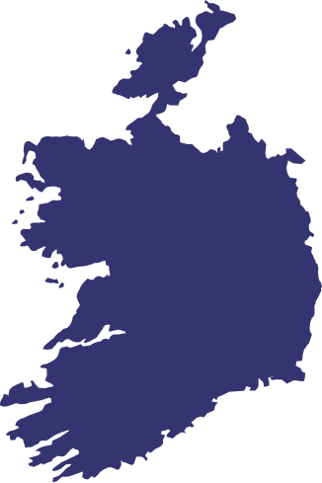
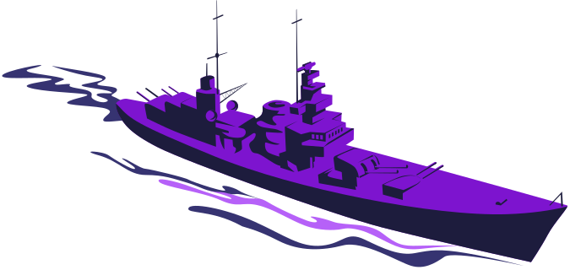
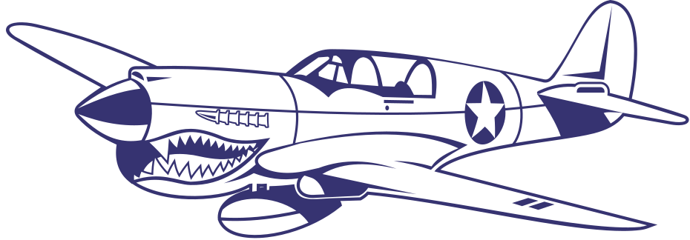



Chapter 25.2
IRELAND DURING THE EMERGENCY
World War II breaks out; de Valera declares a state of Emergency as Ireland declares neutrality.
The Belfast Blitz, requiring aid from Ireland to battle fires. Dublin is also, mistakenly, bombed by Germany
Rationing orders are laid before Dáil Éireann.
1937
1939
1940
1941
1945
1946
1949
Strand Two & Three: The History of the World
Chapter Twenty-Five: World War II
The Irish Constitution, Bunreacht na hÉireann, is established.
As Battle of Britain takes place, Germany mistakenly bombs Co. Wexford.
Victory in Europe Day marks the end of the war in Europe; Victory in Japan Day marks the end of the war.
The Republic of Ireland is established, completing full Irish independence from Britain.
@MsDoorley

Slide 88
Learning Outcomes
2.5 IDENTIFY the causes, course and consequences of the Northern Ireland Troubles and their impact on North– South and Anglo-Irish relations
2.8 DESCRIBE the impact of war on the lives of Irish people, referring to either World War I or World War II
1.2 CONSIDER contentious or controversial issues in history from more than one perspective and discuss the historical roots of a contentious or controversial issue or theme in the contemporary world
1.7 DEVELOP historical judgements based on evidence about personalities, issues and events in the past, showing awareness of historical significance
1.9 DEMONSTRATE awareness of the significance of the history of Ireland and of Europe and the wider world across various dimensions, including political, social, economic, religious, cultural and scientific dimensions
1.11 MAKE CONNECTIONS AND COMPARISONS between people, issues and events in different places and historical eras
Strand Two & Three: The History of the World
Chapter Twenty-Five: World War II
@MsDoorley

Slide 89
Introduction
The Emergency was the name given to the effect of World War II on Ireland between 1939 and 1945. During World War II, the South of Ireland, known as Éire, remained neutral and took no official part in the war. However, Northern Ireland fought on the side of Britain. World War II had a large impact on people's lives. It also deepened the divide between north and south.
Strand Two & Three: The History of the World
Chapter Twenty-Five: World War II
@MsDoorley

Slide 90
1939-1945
Chapter 25
25.6.1: IRELAND ON THE EVE OF WORLD WAR II
25.6.1: ireland on the eve of world war ii
Strand Two: The History of Ireland
@MsDoorley

Slide 91
Changes in Ireland before 1939
Cumann na nGaedheal remained in power until 1932, having faced many challenges since the Civil War - not least restoring law and order after years of better conflict. It set up an Garda Síochána in 1925. It also began to modernise the country by building the first hydroelectric scheme at Ardnacrusha in Co. Clare on the River Shannon in 1929, and founding the Electricity Supply Board (ESB). However, the party had become increasingly unpopular for a number of reasons:
  The country was still heavily reliant on agriculture and had little industry.
  From 1929, the economic Great Depression affected the whole Western world severely for over a decade, increasing unemployment, poverty and emigration.
  The party had made no progress in dismantling the terms of the Anglo-Irish Treaty.
  It continued to introduce unpopular Public Safety Acts to support law and order.
Fianna Fáil was founded by Éamon de Valera in 1926 after he left Sinn Féin. Other Sinn Féin members such as Frank Aiken and Seán Lemass joined him. Fianna Fáil was highly organised and on the rise. Kevin O'Higgins was assassinated in 1927 and W.T. Cosgrave introduced the Electoral Amendment Act. This act stated that all elected TDs had to take the oath of allegiance to the British monarch or give up their seats in the Dáil. De Valera and Fianna Fáil decided to take the oath of allegiance.
Fianna Fáil won the most seats in the 1932 general election and, with the help of Labour, entered government.
Strand Two & Three: The History of the World
Chapter Twenty-Five: World War II
@MsDoorley

Slide 92
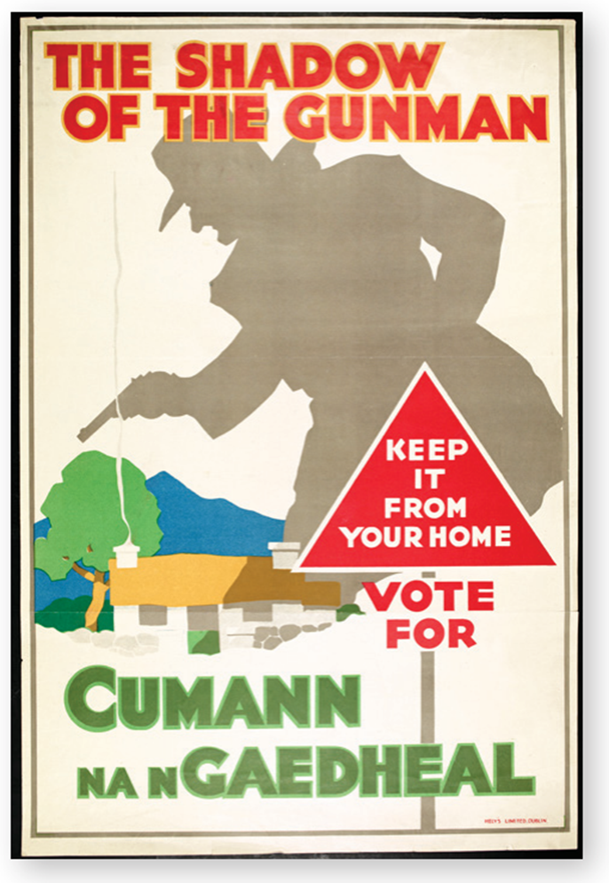

Fianna Fáil | 72 seats
Cumann na nGaedhael | 56 seats
Labour Party | 7 seats
Others | 18 seats
Strand Two & Three: The History of the World
Chapter Twenty-Five: World War II
Diagram taken from Artefact, 2nd Edition by Eimear Jenkinson and Gregg O'Neill (educate.ie)
@MsDoorley

Slide 93
Fianna Fáil in power (1932-1948)
By 1939, Fianna Fáil had achieved progress on several fronts:
  Dismantling the Anglo-Irish Treaty:
    It removed the Oath of Allegiance in 1933; the Statute of Westminster allowed Commonwealth countries to pass laws without interference from Britain.
    It sidelined the position of the governor-general.
    References to the British Monarch were removed from the Irish Constitution in 1936.
  A new constitution, Bunreacht na hÉireann, was passed in 1937. It stated that:
    The country was now to be called Éire or Ireland.
    The Prime Minister was to be called an Taoiseach.
    the head of the country was to be a President – Douglas Hyde became the first President of Ireland.
    It claimed the right to assert control over the entirety of the island of Ireland (this was removed following the Good Friday Agreement in 1998).
Strand Two & Three: The History of the World
Chapter Twenty-Five: World War II
@MsDoorley

Slide 94
Fianna Fáil in power (1932-1948)
  De Valera decided to stop paying Britain land annuities - the repayments of loans given to Irish farmers by Britain to buy their farms. In responses, Britain placed a tariff (tax) of 20% of all Irish agricultural goods. This caused great hardship for Irish farmers, as 83% of their exports went to Britain. De Valera retaliated by putting a 5% tariff on British goods entering Ireland. This was known as the Economic War.
  Welfare payments were introduced for widows and orphans in 1933 and unemployment assistance was introduced in 1935.
  Ten thousand more houses were built than during Cumann na nGaedheal's time in government.
  The IRA was banned in 1936 and 500 members were imprisoned in 1939 after they began bombing Britain.
Strand Two & Three: The History of the World
Chapter Twenty-Five: World War II
@MsDoorley

Slide 95

Éamon de Valera, 1882-1975
Éamon de Valera was born in New York to a Spanish father and an Irish mother. He lived with his grandmother in Limerick from the age of two. He graduated with a degree in Mathematics from UCD. He was a member of the Gaelic League, the Irish Volunteers and the IRB. During the 1916 Rising, he commanded the garrison at Boland's Mill. He was sentenced to death, but this was changed to life in prison as he held American citizenship and the British government didn't want to risk any conflict with the USA. He was released in June 1917. From June 1919 to December 1920, de Valera raised $6 million from Irish Americans to support an Irish government. He returned to Ireland towards the end of the War of Independence. He was president of Sinn Féin from 1917 to 1926. He opposed the Anglo-Irish Treaty and resigned when the Dáil passed it. De Valera founded Fianna Fáil in 1926. He led the creation of the 1937, Bunreacht na hÉireann. He was head of government from 1932 and Taoiseach three separate times: 1937-1948, 1951-1954, 1957-1959. De Valera was President of Ireland from 1959 to 1973. He died in 1975 and is buried in Glasnevin Cemetery.
Strand Two & Three: The History of the World
Chapter Twenty-Five: World War II
@MsDoorley

Slide 96
Checkpoint pg. 250 (Artefact, 2nd Edition)
  Give two success of the Cumann na nGaedheal government.
  Why had Cumann na nGaedheal become less popular?
  Who founded Fianna Fáil? Why did he do this?
  How did Fianna Fáil dismantle the Anglo-Irish Treaty?
  What changes did Fianna Fáil introduce into Ireland?
Strand Two & Three: The History of the World
Chapter Twenty-Five: World War II
@MsDoorley

Slide 97
Checkpoint pg. 250 (Artefact, 2nd Edition)
1. It set up an Garda Síochána in 1925. It also began to modernise the country by building a hydroelectric scheme at Ardnacrusha on the River Shannon in 1929, and founded the Electricity Supply Board (ESB).
2. The country was still heavily reliant on agriculture and had little industry; the Great Depression had led to an increase in unemployment, poverty and emigration; there had been no progress in dismantling the terms of the Anglo-Irish Treaty; Cumann na nGaedheal continued to introduce the controversial Public Safety Acts.
3. Éamon de Valera founded Fianna Fáil in 1926. He had left Sinn Féin and needed a new political party to pursue his goals.
4. Fianna Fáil removed the Oath of Allegiance in 1933; they sidelined the position of governor-general; references to the British monarch were removed from the Irish Constitution in 1936.
5. Land annuities were abolished; welfare payments were introduced for widows and orphans in 1933; unemployment assistance was introduced in 1935; 10,000 more houses were built than during Cumann na nGaedheal’s government; the IRA was banned in 1936.
Strand Two & Three: The History of the World
Chapter Twenty-Five: World War II
@MsDoorley

Slide 98
1939-1945
Chapter 25
25.6.2: NEUTRALITY AND THE EMERGENCY POWERS ACT
25.6.2: neutrality and the emergency powers act
Strand Two: The History of Ireland
@MsDoorley

Slide 99
Ireland's Neutrality in World War II
World War II broke out in September 1939. Ireland declared itself to be a neutral country. Neutrality involves not fighting in a war and not supporting either side. The country remained neutral because:
  Ireland was a new state, struggling to develop its economy and politics.
  Ireland wanted to continue to show its independence from Britain.
  Ireland was ill-prepared to fight in a war.
  Ireland's economy was weak and would be further damaged by war.
  Staying out of World War II was a popular decision with all political parties.
However, while Ireland was officially neutral, the government did favour the Allies - Britain, France and the United States. This can be seen in the fact that:
  Ireland allowed Allied planes to fly over Donegal from Northern Ireland.
  Ireland passed on weather reports and intelligence on sightings of U-boats and German shipping in Irish waters to the Allies.
  German airmen were imprisoned if caught, while British and Americans were allowed to 'escape' over the border.
  Irish fire brigades went to Belfast to help with the aftermath of the Belfast Blitz.
  Around 50,000 Irishmen joined the British army.
Strand Two & Three: The History of the World
Chapter Twenty-Five: World War II
@MsDoorley

Slide 100

Strand Two & Three: The History of the World
Chapter Twenty-Five: World War II
Diagram taken from Artefact, 2nd Edition by Eimear Jenkinson and Gregg O'Neill (educate.ie)
@MsDoorley

Slide 101

The Emergency Powers Act 1939
This period in Ireland was named 'the Emergency' after a law called The Emergency Powers Act was passed by government after the war was declared. Under it, the government to go to great lengths to ensure that Ireland stayed neutral. Newspapers were strictly censored: they could not share any news that might show a bias towards either side. Plays, poetry and books were also censored. Even people's post could be opened and examined if the government felt the need to do so.
Strand Two & Three: The History of the World
Chapter Twenty-Five: World War II

Slide 102
Checkpoint pg. 252 (Artefact, 2nd Edition)
  Explain the term neutrality.
  Why did Ireland stay neutral during World War II?
  What evidence is there that Ireland favoured the Allied side?
  What changes were introduced by the Emergency Powers Act 1933?
  Why do you think that strict censorship was introduced in Ireland during World War II?
Strand Two & Three: The History of the World
Chapter Twenty-Five: World War II
@MsDoorley

Slide 103
Checkpoint pg. 252 (Artefact, 2nd Edition)
1. Neutrality: not fighting in the war and not supporting either side.
2. Ireland wanted to continue to show its independence from Britain; Ireland was ill-prepared to fight in a war; Ireland’s economy was weak; political parties wanted to stay out of World War II.
3. Ireland allowed Allied planes to fly over Donegal from Northern Ireland; Ireland passed on weather reports and intelligence on sightings of U-boats and German shipping in Irish waters to the Allies; German airmen were imprisoned if caught, while British and Americans were allowed to ‘escape’ over the border; Irish fire brigades went to Belfast to help after the bombings; around 50,000 Irishmen joined the British Army.
4. The Emergency Powers Act meant that the government could go to great lengths to ensure that Ireland stayed neutral: newspapers were censored, along with plays, poetry and books, and people’s private post could even be opened.
5. Strict censorship was introduced so that newspapers could not share any news that might show a bias towards either side. Ireland had to be seen to be neutral.
Strand Two & Three: The History of the World
Chapter Twenty-Five: World War II
@MsDoorley

Slide 104
1939-1945
Chapter 25
25.6.3: IMPACT OF WORLD WAR II ON IRELAND
25.6.3: impact of world war ii on ireland
Strand Two: The History of Ireland
@MsDoorley

Slide 105
Shortages and rationing
Ireland relied on imports of food and other items. This was a problem during the war as German U-boats were stopping British ships from bring supplies to and from Britain, affecting imports and exports to Ireland. Seán Lemass was appointed as Minister for Supplies during the war. He had to make sure Ireland had enough essentials to keep functioning in wartime. To achieve this, he set up the Irish Shipping Ltd. to transport goods to Ireland in 15 cargo ships. Fuel and some foods remained in short supply, however. Lemass also set up the Compulsory Tillage Scheme, which meant that all farmers had to till a certain acreage of wheat. The flour was poor quality and the bread was nicknamed black bread.
Limits on food, clothes, footwear and so forth were introduced due to the shortages. People were given ration books, which contained coupons that could be exchanged for goods in shops. This method of rationing limited the goods people could buy in a fixed amount. Tea, flour, butter, sugar, petrol and other essentials were hard to get. People dried out and reused their tea leaves.
Strand Two & Three: The History of the World
Chapter Twenty-Five: World War II
@MsDoorley

Slide 106


Strand Two & Three: The History of the World
Chapter Twenty-Five: World War II
Diagram taken from Artefact, 2nd Edition by Eimear Jenkinson and Gregg O'Neill (educate.ie)
@MsDoorley

Slide 107

Fuel Shortages and the glimmer men
Electricity and gas were in short supply and had to be rationed. Government inspectors called glimmer men called to houses in towns and cities to check people were not overusing gas. If you were using more than your allowed amount, you could be cut off or prosecuted in courts.
Petrol was extremely limited, and was only really used by doctors and priests. Ireland had imported a lot of its coal from Britain, and this was hard to do during the war. Turf replaced coal as a fuel. The army was put to work cutting turf from bogs around Ireland. Trains had to be run on turf and took longer to get to their destinations as a result. Irish industry was greatly affected by the fuel shortages. Factors had to lay off workers, so emigration from Ireland increased. People moved to Britain to work in the busy factories there. Agriculture was also affected by a lack of products such as fertilisers and animal feeds.
Strand Two & Three: The History of the World
Chapter Twenty-Five: World War II
Diagram taken from Artefact, 2nd Edition by Eimear Jenkinson and Gregg O'Neill (educate.ie)
@MsDoorley

Slide 108

Air Raids
Despite its neutrality, Ireland was bombed by the Germans although it is believe this was by accident. For example, in 1940, bombs were dropped in Campile, Co. Wexford, killing three people. In 1941, a house in Knockroe, Co. Carlow was destroyed, killing three people and injuring two others. Another bombing took place in North Strand in Dublin, killing 28 people - this was the most fatal attacked. Although the Germans claimed these were accidents, the North Strand in particular could have been a message to the Irish government to remind them of the consequences of having any involvement in World War II.
Strand Two & Three: The History of the World
Chapter Twenty-Five: World War II
Diagram taken from Artefact, 2nd Edition by Eimear Jenkinson and Gregg O'Neill (educate.ie)
@MsDoorley

Slide 109
Checkpoint pg. 254 (Artefact, 2nd Edition)
  Explain the terms rationing and glimmer man.
  What role did Sean Lemass play during the Emergency?
  What was the purpose of the Irish Shipping Company?
  How were the people’s lives affected by (a) rationing and (b) shortages of fuel?
Strand Two & Three: The History of the World
Chapter Twenty-Five: World War II
@MsDoorley

Slide 110
1939-1945
Chapter 25
25.6.4: IMPACT OF WORLD WAR II ON NORTHERN IRELAND
25.6.4: impact of world war ii on northern ireland
Strand Two: The History of Ireland
@MsDoorley

Slide 111


Industry and Agriculture
As part of the United Kingdom, Northern Ireland fought on behalf of Britain. While conscription was not compulsory, rationing was. After World War I, Northern Irish industries had struggled, but from 1939 they boomed. Companies such as Harland and Wolff (shipyard) and Short Brothers (an aircraft factory) played key roles in the war. Between 1939 and 1945, Belfast produced 140 warships, 123 merchant ships and 1,600 fighting aircraft during the war. Parachutes, ropes, uniforms, tanks and shells were produced in Northern Ireland. Unemployment fell from 20% to 5%.
Northern Irish agriculture benefitted from World War II as well. Prices were guaranteed for food on the British market. In 1941, over 17,000 gallons of milk were being exported to Britain every day. Compulsory tillage farming led to an increase in the acreage being used for growing flax, oats and potatoes. Even some golf courses were used for tillage farming.
Strand Two & Three: The History of the World
Chapter Twenty-Five: World War II
Diagram taken from Artefact, 2nd Edition by Eimear Jenkinson and Gregg O'Neill (educate.ie)
@MsDoorley

Slide 112

Northern Ireland as a base for troops
Planes and boats were based in Northern Ireland to patrol the Atlantic for German U-boats. They helped protect supplies being transported between the islands of Ireland and Great Britain. Northern Ireland became an important base for US troops once they entered the war in December 1941. They were either protecting trade across the Atlantic or preparing for the Allied invasion of Normandy. Roads and ports had to be improved to cope with the added traffic of US troops - at one stage there was 120,000 US troops stationed in Northern Ireland.
Strand Two & Three: The History of the World
Chapter Twenty-Five: World War II
Diagram taken from Artefact, 2nd Edition by Eimear Jenkinson and Gregg O'Neill (educate.ie)
@MsDoorley

Slide 113
The Belfast Blitz
Due to the amount of industry in Belfast, it was one of the major target cities for the German military. It was not well defended because the government thought it was too far away for the Luftwaffe to reach. Belfast city was bombed four times, with the period becoming known as the Belfast Blitz.
  7th and 8th April 1941 – 13 dead, not much damage. Northern Ireland government did little to prepare.
  15th and 16th April 1941 – Flares dropped to light up targets before high explosives, incendiaries and parachute mines. Working class areas destroyed. 900 dead, many unidentified.
  5th May 1941 – Harland and Wolff’s destroyed. Almost 200 dead.
It was the most severe bombing of a British city except for London, with about 1,100 killed and over 56,000 homes were destroyed. Great numbers of people left the city to move to towns outside of Belfast while some slept in ditches or took refuge in Éire.
Strand Two & Three: The History of the World
Chapter Twenty-Five: World War II
Diagram taken from Artefact, 2nd Edition by Eimear Jenkinson and Gregg O'Neill (educate.ie)
@MsDoorley

Slide 114

Strand Two & Three: The History of the World
Chapter Twenty-Five: World War II
Diagram taken from Artefact, 2nd Edition by Eimear Jenkinson and Gregg O'Neill (educate.ie)
@MsDoorley

Slide 115
Checkpoint pg. 256 (Artefact, 2nd Edition)
  How did World War II affect (a) industry and (b) agriculture in Northern Ireland?
  Why were American soldiers stationed in Northern Ireland?
  Why was Belfast attacked by the Luftwaffe?
  What impact did the bombing have on Belfast?
Strand Two & Three: The History of the World
Chapter Twenty-Five: World War II
@MsDoorley

Slide 116
Checkpoint pg. 256 (Artefact, 2nd Edition)
1. (a) Industry boomed in Northern Ireland. Unemployment levels dropped by 20% to only 5%. Companies such as Harland and Wolff and Short Brothers grew in size, producing warships, merchant ships and aircraft; (b) Agriculture in Northern Ireland benefited; prices were guaranteed for food on the British market; over 17,000 gallons of milk were being exported to Britain every day; tillage farming expanded.
2. US soldiers were based in Northern Ireland either to protect trade across the Atlantic or to prepare for the Allied invasion of Normandy.
3. Belfast was bombed because of how much key wartime industry it had, and the fact that it was not well defended meant it was low-risk for the bombers.
4. Factories such as Harland and Wolff were seriously damaged. About 1,100 people were killed and over 56,000 homes were destroyed. Great numbers of people left the city for safety, and many took refuge south of the border.
Strand Two & Three: The History of the World
Chapter Twenty-Five: World War II
@MsDoorley

Slide 117
1939-1945
Chapter 25
25.6.5: POST-WAR DIVIDE BETWEEN NORTH AND SOUTH
25.6.5: post-war divide between north and south
Strand Two: The History of Ireland
@MsDoorley

Slide 118
North and South move further apart
The experience of World War II in Northern Ireland was completely different to that of the rest of the island.
  Éire did not suffer the heavy bombing and huge loss of life as Northern Ireland did.
  Éire’s economy suffered while the North’s improved. Only several years after the war was over could rationing be ended in the south.
  The contribution of Northern Ireland to the war effort meant that its ties to Great Britain became even stronger.
  The fact that Éire had stayed neutral created a bigger gap between north and south. It demonstrated the south’s independence, but damaged its relations with the North and Britain.
  When President Roosevelt died on the 12th April 1945, de Valera expressed his condolences. However, he did the same to the German people when Hitler died on the 20th April. This action was criticised by many, as it appeared that de Valera (and Ireland) did not recognise the horrors that had been committed by Hitler and the Nazis.
Strand Two & Three: The History of the World
Chapter Twenty-Five: World War II
@MsDoorley

Slide 119


Commemorating World War II
In 1984, a park in Dublin's Irishtown became the site of a new memorial to Irish merchant seamen lost during the Emergency. During World War II, the Irish Mercantile Marine was solely responsible for the transport of supplies to and from Ireland. Sixteen ships were lost at sea during the war and 150 men died. A granite memorial was unveiled in memory of all those who sailed and those who did not return. Wreaths were laid and students from local schools planted trees.
In his speech to the nation after World War II had ended, Éamon de Valera said:
'To the men of our mercantile marine who faced all the perils of the ocean to bring us essential supplies, the nation is profoundly grateful'.
In 1991, a newer memorial, the Seaman's Memorial, was unveiled near Dublin's docks.
Strand One: The Nature of History
Chapter Twenty-Five: World War II
Diagram taken from Artefact, 2nd Edition by Eimear Jenkinson and Gregg O'Neill (educate.ie)
@MsDoorley

Slide 120
Checkpoint pg. 208 (Artefact, 2nd Edition)
  How did World War II affect the economies of Ireland, north and south?
  Why do you think the link between Northern Ireland and Britain was strengthened by the war?
  Why did the war push the two parts of Ireland further apart?
  How do you think the war impacted on relations between Ireland and Britain? Give reasons for your answer.
Strand Two & Three: The History of the World
Chapter Twenty-Five: World War II
@MsDoorley

Slide 121
1914-1918
Chapter 21
25.7: SUMMARY
25.7: summary
Strand Two & Three: The History of the World
@MsDoorley

Slide 122
In this chapter, we have learned that...
  To restore Germany's strength as a nation, Hitler defied the Treaty of Versailles by: rebuilding the German army and navy; remilitarising the Rhineland; and seeking to unite all German-speakers into a greater German Empire, the Third Reich.
  In March 1938, Hitler absorbed Austria into the Third Reich in an event called the Anschluss.
  Hitler invaded the Sudetenland in the autumn of 1938. In March 1939 he invaded the rest of Czechoslovakia, breaking the promise he had made in Munich to France, Britain and Italy.
  At the Munich Conference, Britain and France had used the policy of appeasement in the hope that Hitler would be content with Austria and the Sudetenland and war could be avoided.
  Hitler and Stalin signed the Nazi-Soviet Non-Aggression Pact in August 1939.
  On 1st September 1939, Hitler invaded Poland using Blitzkrieg tactics. World War II was declared two days later.
  The German invasion of France began on the 10th May 1940, again using Blitzkrieg tactics.
  On the 13th August 1940, the aerial Battle of Britain began. It was won by the RAF.
  In the Blitz (September 1940-May 1941), the Germans dropped explosive and incendiary bombs on London and other British cities.
  On the 22nd June 1941, Germany invade Russia in a three-pronged attack towards the most important cities: Moscow, Leningrad and Kiev. This was known as Operation Barbarossa.
Strand Two & Three: The History of the World
Chapter Twenty-Five: World War II
@MsDoorley

Slide 123
In this chapter, we have learned that...
  Soviet victory in the long, vicious Battle of Stalingrad over the winter of 1942-1943 was a turning point in the war.
  The USA entered World War II in December 1941, when Japan attacked the US Pacific fleet at Pearl Harbour.
  The Battle of the Atlantic was when German U-boats attacked US supplies reaching Britain.
  The Allies bombed German industrial zones and also civilians in German cities.
  The Allied invasion of France (D-Day) took place on the 6th June 1944.
  Victory in Europe Day (VE Day) is the 8th May. Victory over Japan Day (VJ Day) is the 15th August.
  The lives of people in wartime Britain and occupied France were greatly impacted by World War II.
  Roughly 60 million people died in World War II while another 40 million were displaced.
  Some other consequences were: many countries of Central and Eastern Europe came under USSR control and became communist; trials of Nazi war criminals took place in Nuremberg; the USA and the USSR were now the two most powerful countries in the world; tensions between the US and USSR developed into the Cold War; numerous cities were destroyed; Britain and France were weak after the war and their colonies began to demand independence; the United Nations and the EEC were founded.
Strand Two & Three: The History of the World
Chapter Twenty-Five: World War II
@MsDoorley

Slide 124
In this chapter, we have learned that...
  Cumann na nGaedheal were in government until 1932. They had become increasingly unpopular. Fianna Fáil and the Labour Party formed the new government in 1932. Fianna Fáil began to dismantle the Anglo-Irish Treaty. The Irish Free State became Éire/Ireland.
  Ireland declared itself neutral when World War II broke out. The government created the Emergency Powers Act in 1939, which meant they were able to go to great lengths to ensure that Ireland stayed neutral, for instance through censorship.
  Many items were in short supply in Ireland/Éire, which led to rationing. The Irish Shipping Company was set up to bring supplies to and from Ireland. Inspectors called glimmer men were employed to check people's fuel usage. Irish turf was used instead of imported coal. Several places in Éire was bombed by Germany, claimed to be by accident.
  Northern Ireland's industry and agriculture improved during World War II. It was attacked by German bombers due to its factories in industrial areas such as Belfast and was also used as a base for American troops.
  After the war, the divide between the north and south of the island of Ireland was even wider than before. Northern Ireland's industries had grown and its relationship with Britain had become stronger.
Strand Two & Three: The History of the World
Chapter Twenty-Five: World War II
@MsDoorley

Slide 125
Reflecting on... World War II
In determination to restore Germany to strength. Hitler was willing to act step by step and made strategic pacts and alliances, so that the other powers would not move against him before Germany was ready for a full-scale war. In hindsight, the policy of appeasement would seem naïve. Its noble intention was to prioritise peace and save lives, but it came up against the Nazi vision of a Third Reich that was theirs for the taking.
World War II had an enormous impact on the world, particularly Europe. It took a long time to recover from years of widespread destruction. The impact of war is not always immediate. For example, the Cold War tensions stemmed from the new boundaries and balances of power in the wake of World War II. The desire for lasting peace would lead to the creation of the United Nations and the EEC/EU.
World War II had a large impact on the lives of Irish people, north and south. The two parts of the island had very different experiences of World War II, with the relationship between Northern Ireland and Britain strengthening and the independence of Ireland becoming clear.
Strand Two & Three: The History of the World
Chapter Twenty-Five: World War II
@MsDoorley

Slide 126
SEC Examination Questions
2023 SEC Q5
Educate.ie Papers
Strand Two & Three: The History of the World
Chapter Twenty-Five: World War II
Sample A Q7 - pg. 120
Sample C Q8 - pg. 176
Sample D Q5 - pg. 197
Sample F Q5 - pg. 251
@MsDoorley

Slide 127
Project
Guidelines:
  Length: The depth of your project should reflect about 2-3 weeks of work.
  Sources: Use at least three different sources for your research. These can be books, scholarly articles, or reputable online resources.
  Citations: All information and images that are not your own should be properly cited.
  Mediums: You may choose to present your project in one of the following ways:
    Poster: Your poster should be informative and visually engaging.
    Minecraft or Lego Model: If choosing this option, please also include a brief report explaining your model.
    Painting/Drawing: Your artwork should be accompanied by a description.
    Recycled Materials: Create your model using recycled materials and provide an explanation of your creative process.
Assessment:
Your projects will be assessed based on:
  Research and Content
  Creativity and Presentation
  Understanding of Context
  Adherence to Guidelines
Strand Two & Three: The History of the World
Chapter Twenty-Five: World War II
@MsDoorley

Slide 128
Project
Historical Sites
Historical Figures
Normandy Beaches, France
Pearl Harbour, Hawaii, USA
Hiroshima Peace Memorial, Hiroshima, Japan
Stalingrad (now Volgograd), Russia
Trinity Site, New Mexico, USA
Adolf Hitler
Nevil Chamberlain
Benito Mussolini
Franklin D. Roosevelt
Emperor Hirohito
Winston Churchill
Harry Truman
General Eisenhower
General Patton
General Rommel
General Montgomery
General Manstein
Marshal Zhukov
General Tojo
General Yamashita
The O’Sullivan Brothers
J. Robert Oppenheimer
Lyudmila Pavlichenko
Virginia Hall
Josephine Baker
Barbara Lauwers
Nancy Wake
Éamon de Valera
Seán Lemass
James Craig
Basil Brookeborough
Hames Magennis
Lord Haw-Haw
Paddy Finucane (RAF)
Strand Two & Three: The History of the World
Chapter Twenty-Five: World War II
@MsDoorley

